Slide 1
Summary of Root Causes

Slide 2
Patch #cd443f1e
general protection fault in strlen
KASAN: stack-out-of-bounds Read in __nla_put

Slide 3
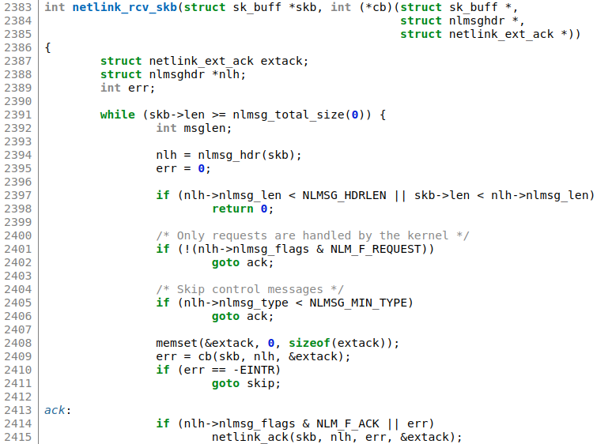
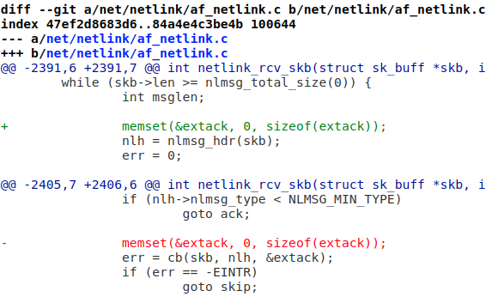
Root Cause Analysis
https://git.kernel.org/pub/scm/linux/kernel/git/torvalds/linux.git/commit/?id=cd443f1e91ca600a092e780e8250cd6a2954b763
Notes:
Uninitialized memory

Slide 4
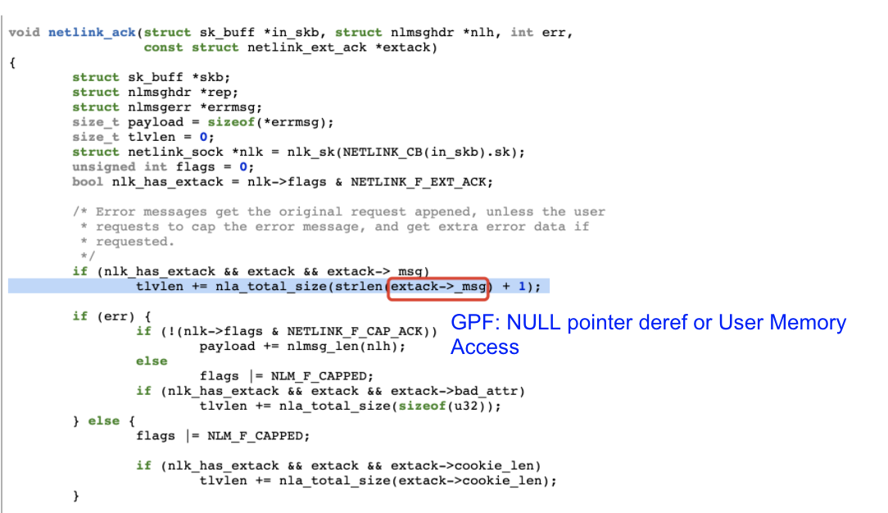
GPF
Notes:
extack uninitialized

Slide 5
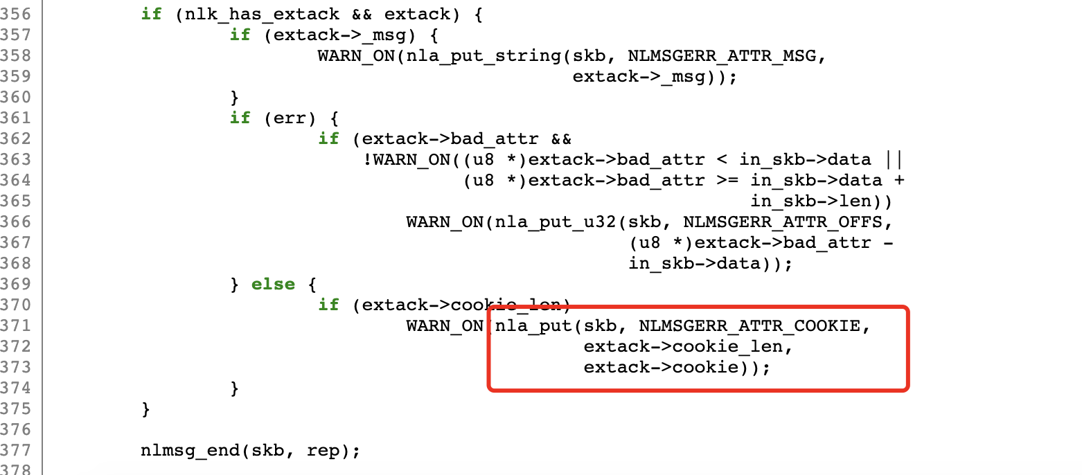
OOB Read
This code snippet is still in the netlink_ack function
Notes:
extack uninitialized

Slide 6
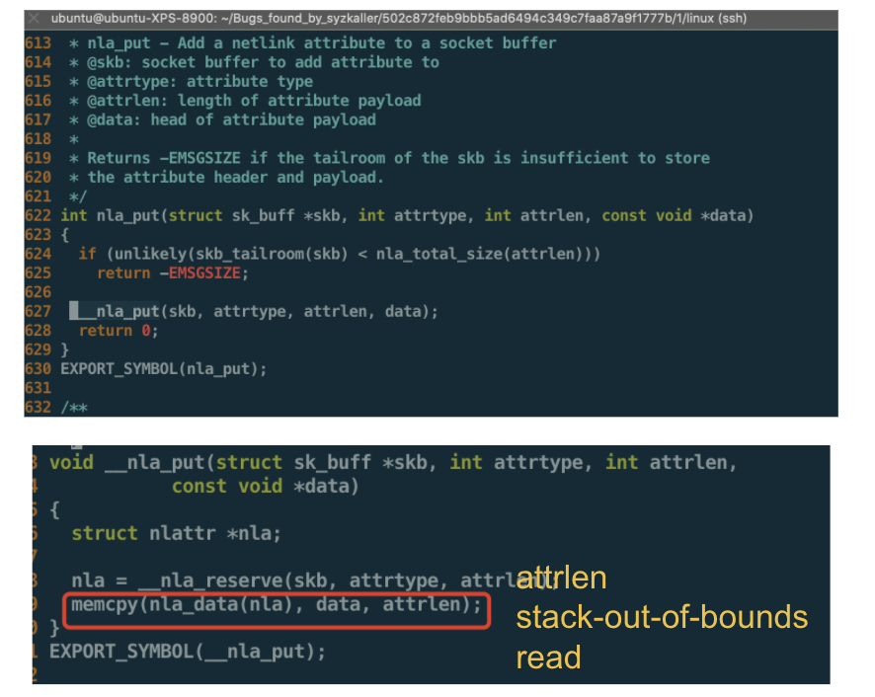
OOB Read
Notes:
extack uninitialized

Slide 7
Patch #2b4f27c3
KASAN: global-out-of-bounds Read in crypto_chacha20_crypt
general protection fault in crypto_chacha20_crypt
BUG: unable to handle kernel paging request in crypto_chacha20_crypt
https://syzkaller.appspot.com/bug?id=544067c32331f97801e2b5b5f83e4f7f7e2665ce
The 3rd bug report is already marked as duplicated with the 2nd bug report
Notes:
Uninitialized memory

Slide 8
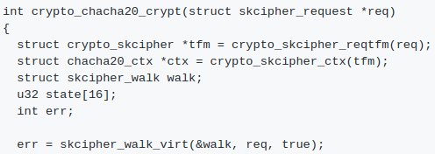
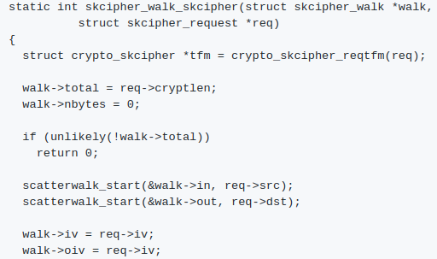
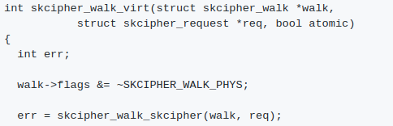
Root Cause Analysis
https://git.kernel.org/pub/scm/linux/kernel/git/torvalds/linux.git/commit/?id=2b4f27c36bcd46e820ddb9a8e6fe6a63fa4250b8

Slide 9
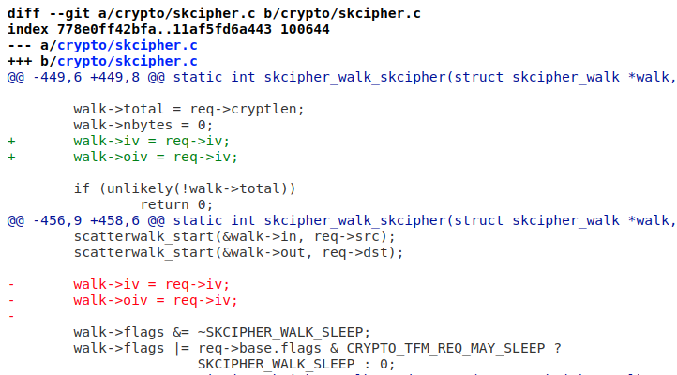
Root Cause Analysis
https://git.kernel.org/pub/scm/linux/kernel/git/torvalds/linux.git/commit/?id=2b4f27c36bcd46e820ddb9a8e6fe6a63fa4250b8

Slide 10
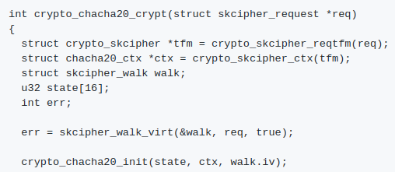
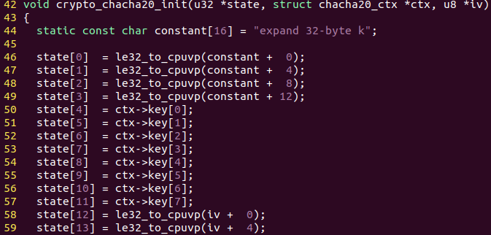
GPF And “unable to handle kernel page request”
walk->iv and walk->iov is not initialized
The access of this uninitialized iv causes “GPF and unable to handle kernel paging request”

Slide 11
OOB Read
walk->iv and walk->iov is not initialized
The access of this uninitialized iv causes “OOB Read”

Slide 12
Patch #153fbd12
KASAN: use-after-free Read in __lock_acquire
KASAN: use-after-free Read in do_raw_spin_unlock
WARNING in get_pi_state

Slide 13
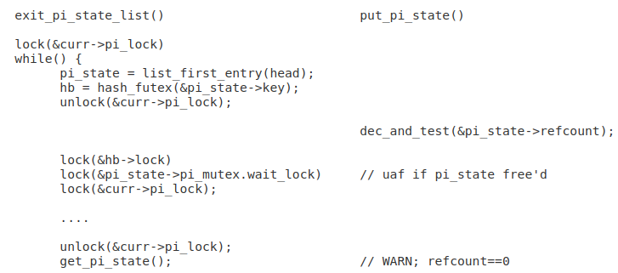
Root Cause Analysis
put_pi_state() vs. exit_pi_state_list() races

Slide 14
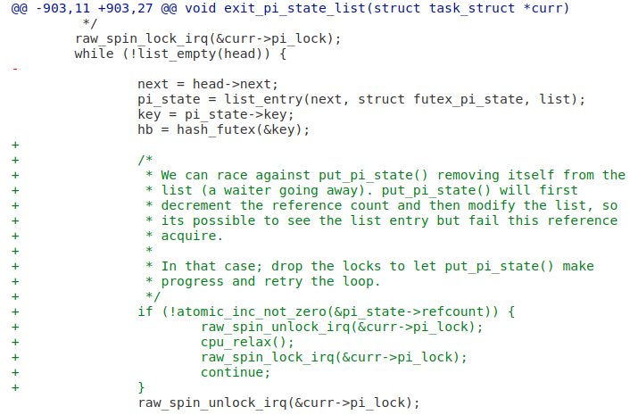
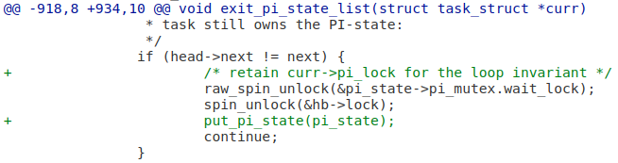
Root Cause Analysis

Slide 15
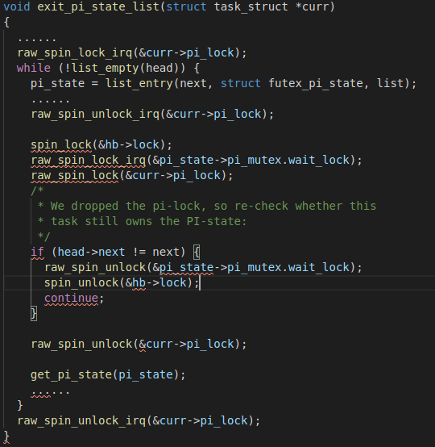
KASAN: use-after-free Read in __lock_acquire
dec_and_test(&pi_state->refcount);

Slide 16
KASAN: use-after-free Read in do_raw_spin_unlock
dec_and_test(&pi_state->refcount);

Slide 17
WARNING in get_pi_state
dec_and_test(&pi_state->refcount);

Slide 18
Patch #6d37fa49
KASAN: use-after-free Read in ip6_hold_safe
KASAN: use-after-free Write in ip6_hold_safe
https://git.kernel.org/pub/scm/linux/kernel/git/torvalds/linux.git/commit/?id=6d37fa49da1e8db8fb1995be22ac837ca41ac8a8
Notes:
Bug on && UAF

Slide 19
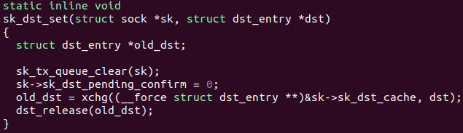
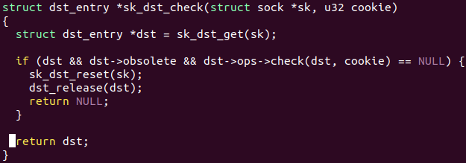
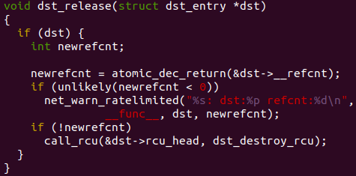
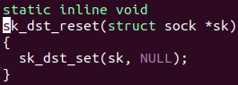
Root Cause Analysis
l2tp: use sk_dst_check() to avoid race on sk->sk_dst_cache
L2tp_xmit_skb
-> __sk_dst_check
udpv6_sendmsg
-> sk_dst_check
Race
Free
sk->sk_dst_cache
Free
Notes:
https://git.kernel.org/pub/scm/linux/kernel/git/torvalds/linux.git/commit/?id=6d37fa49da1e8db8fb1995be22ac837ca41ac8a8

Slide 20
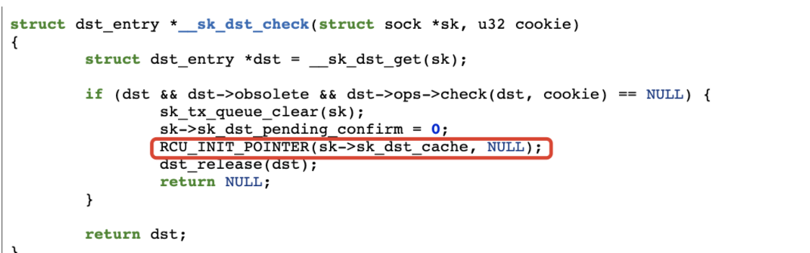
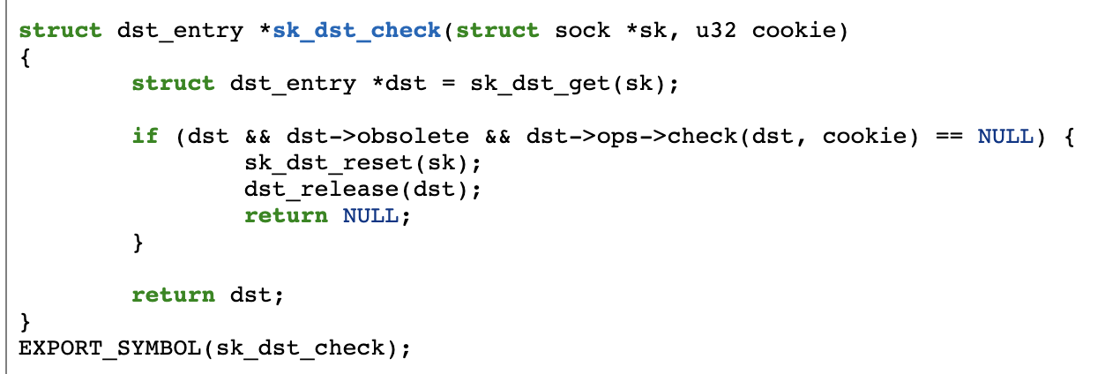
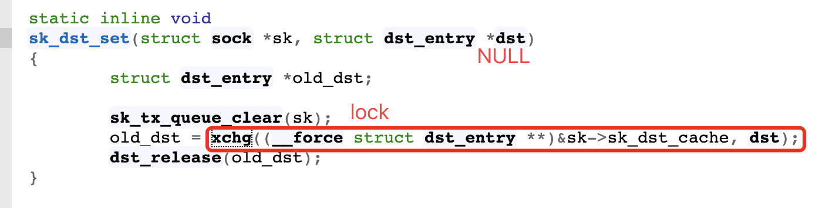
Root Cause Analysis
Notes:
Udpv6_sendmsg is lockless and __sk_dst_check uses rcu_init_pointer to modify the value of pointer. The buffer will be freed multiple times since the reference has not been cleared.

Slide 21
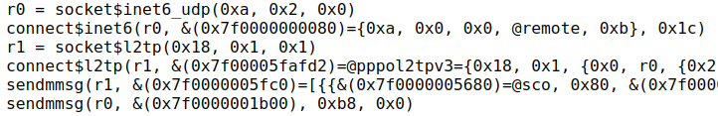
Root Cause Analysis
sendmmsg(r0,...) does not invoke “sk_dst_check” function to refresh sk->sk_dst_cache.
sendmmsg(r1,...) does invoke “__sk_dst_check” function to refresh sk->sk_dst_cache.
So even if you switch two sendmmsg syscalls, there is no any other crash behavior
Allocation in connect$inet6
Free in sendmmsg(l2tp)
Allocation in sendmmsg(udp)

Slide 22
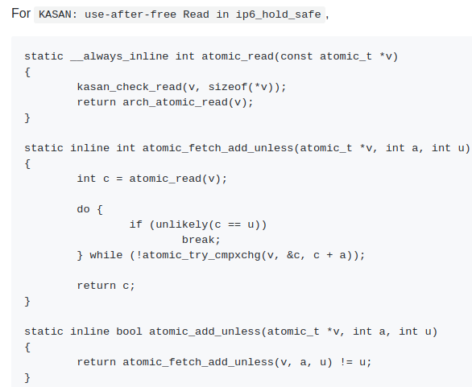
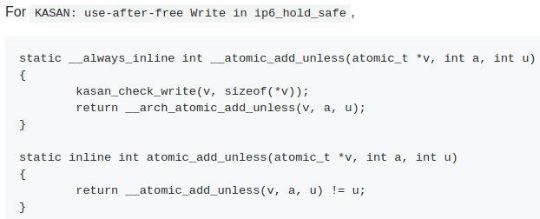
UAF Read and UAF Write

Slide 23
Patch #21eff69a
KMSAN: uninit-value in vcs_read
KMSAN: kernel-infoleak in vcs_read

Slide 24
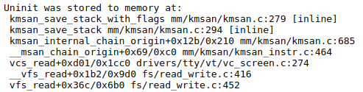
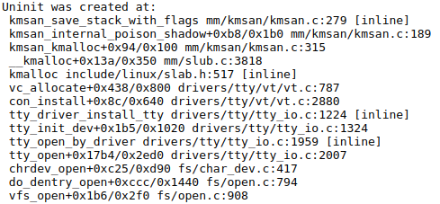
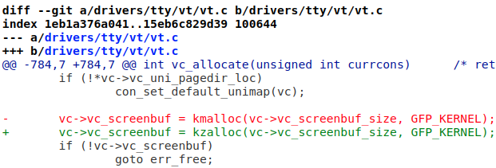
Root Cause Analysis
https://git.kernel.org/pub/scm/linux/kernel/git/torvalds/linux.git/commit/?id=21eff69aaaa0e766ca0ce445b477698dc6a9f55a

Slide 25
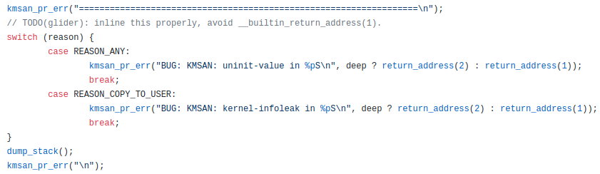
Uninit-value and Info-leak
Different Implementation
Of Kernel Memory Sanitizer

Slide 26
Patch #3619dec5
KASAN: slab-out-of-bounds Write in sha512_final
KASAN: slab-out-of-bounds Write in rmd320_final
KASAN: slab-out-of-bounds Write in tgr192_final
KASAN: slab-out-of-bounds Write in wp384_final
KASAN: slab-out-of-bounds Write in crypto_sha3_final
KASAN: slab-out-of-bounds Write in sha1_finup
KASAN: slab-out-of-bounds Write in sha1_final
KASAN: slab-out-of-bounds Write in tgr160_final
KASAN: slab-out-of-bounds Write in sha512_finup

Slide 27
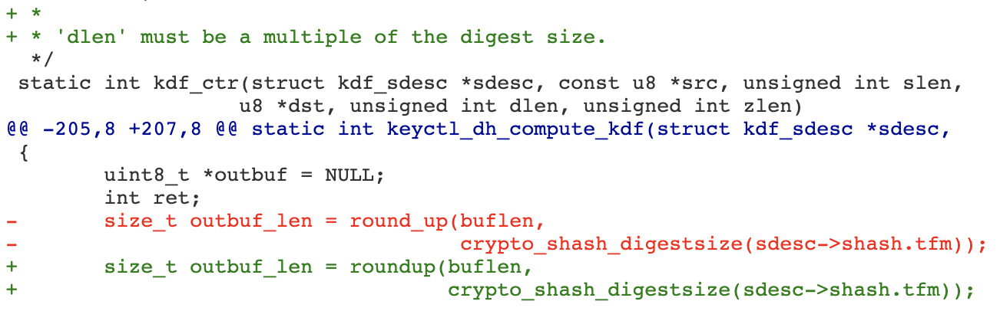
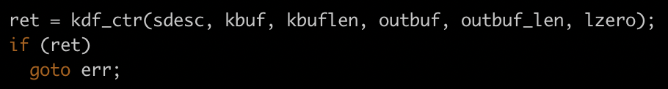
Root Cause Analysis
Commit 383203eff718 ("dh key: get rid of stack allocated array") changed kdf_ctr() to assume that the length of key material to derive is a multiple of the digest size. The length was supposed to be rounded up accordingly. However, the round_up() macro was used which only gives the correct result on power-of-2 arguments, whereas not all hash algorithms have power-of-2 digest sizes. In some cases this resulted in a write past the end of the 'outbuf' buffer.
With buflen unchanged, different encryption schemes have different bytes to overflow.
Notes:
The capability is changed with different encryption mechanisms

Slide 28
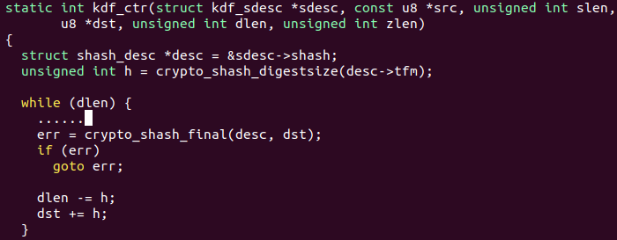
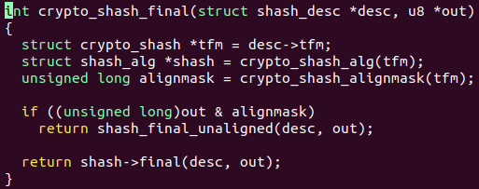
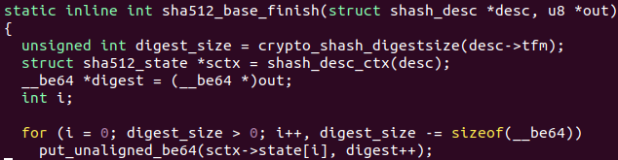
OOB Write
Different crash locations are caused by different parameters in the same syscall
OOB Write occurs
Notes:
The capability is changed with different encryption mechanisms

Slide 29
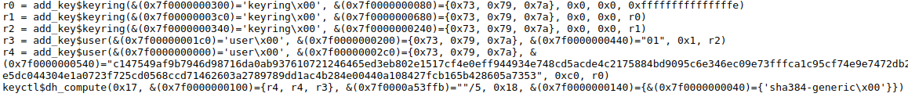
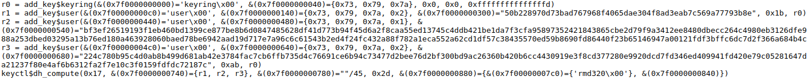
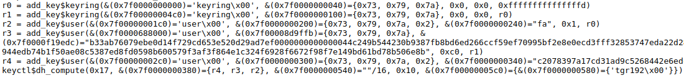
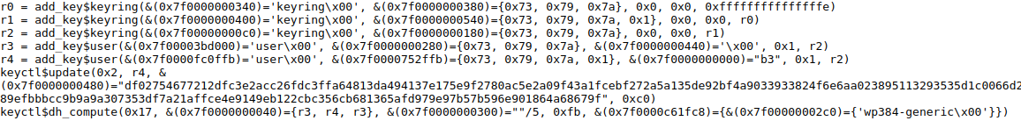
PoC comparison

Slide 30
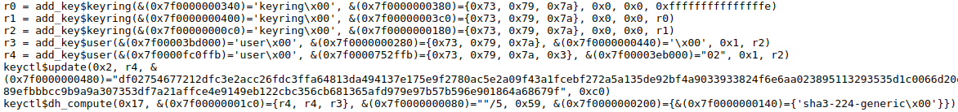
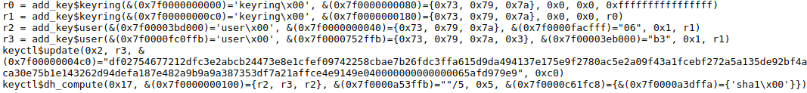
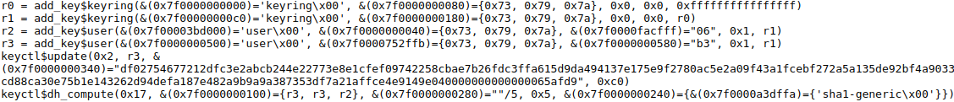
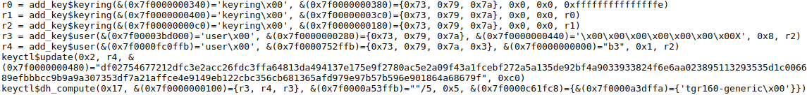
PoC comparison

Slide 31
Patch #b423d13c
KASAN: use-after-free Read in erspan_build_header
KASAN: slab-out-of-bounds Read in erspan_build_header
KASAN: use-after-free Read in erspan_xmit
KASAN: slab-out-of-bounds Read in erspan_xmit
Notes:
The kernel source in case 1 and 2 are different from those in case 3 and 4.

Slide 32
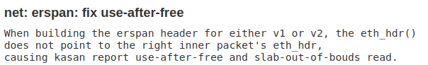
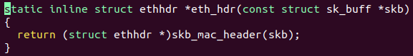
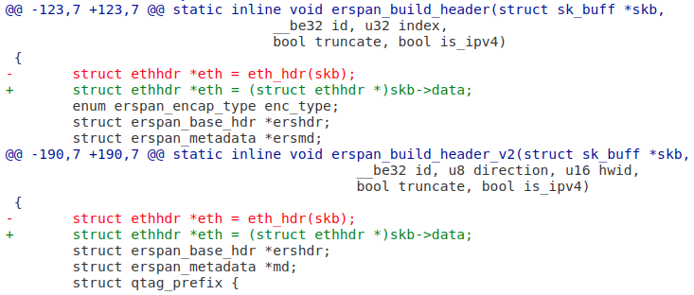
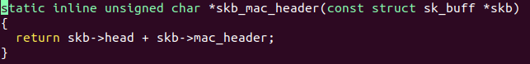
Root Cause Analysis

Slide 33
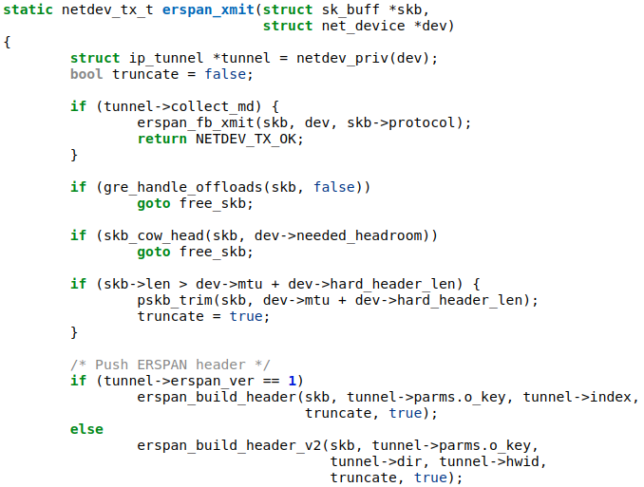
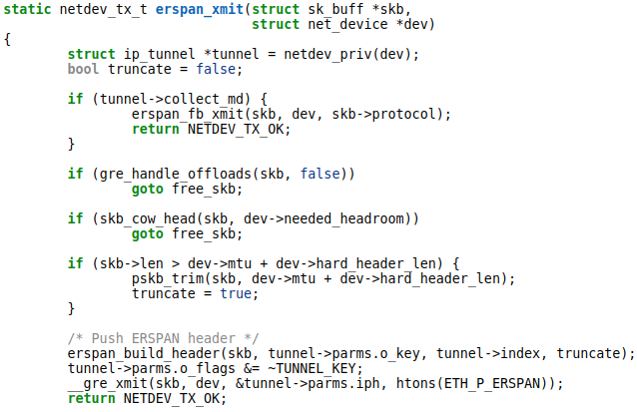
OOB/UAF Read in different locations
Different implementation
between erspan_xmit in both kernel versions
Notes:
eth = eth_hdr(skb); (error offset)

Slide 34
UAF vs OOB in the same location
If the OOB area was freed, KASAN would throw UAF error.
Notes:
eth = eth_hdr(skb); (error offset)

Slide 35
Patch #dc32b5c3
KASAN: slab-out-of-bounds Read in cap_inode_getsecurity
KASAN: slab-out-of-bounds Read in cap_convert_nscap
Notes:
https://git.kernel.org/pub/scm/linux/kernel/git/torvalds/linux.git/commit/?id=dc32b5c3e6e2ef29cef76d9ce1b92d394446150e
Going from different paths, but reaching to the same direction --- the vulnerable function

Slide 36
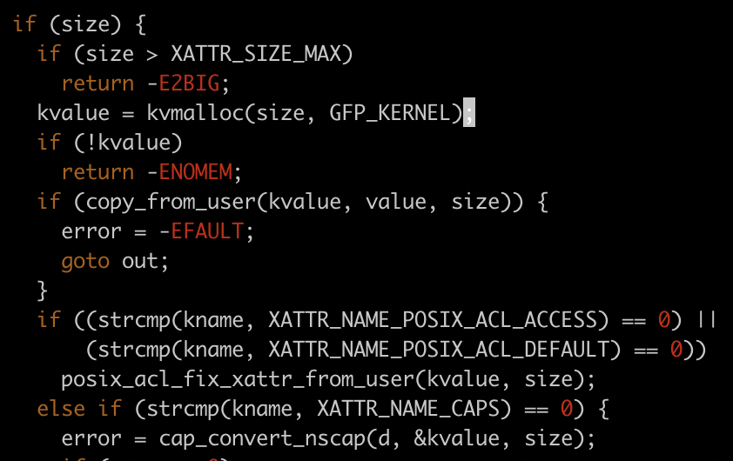
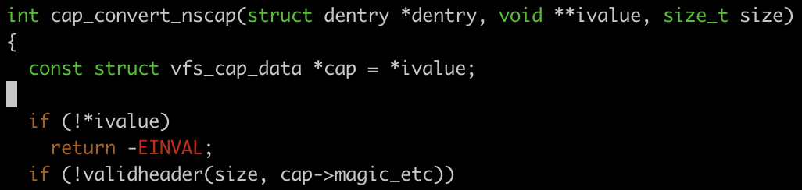

Root Cause Analysis
First, check size is XATTR_CAPS_SZ_2 or XATTR_CAPS_SZ_3, and then fetch the value with le32_to_cpu()

Slide 37


OOB Read in cap_convert_nscap
OOB Read occurs

Slide 38




OOB Read in cap_inode_getsecurity
vfs_setxattr
-> __vfs_setxattr_noperm
-> __vfs_setxattr
-> ext4_xattr_security_set: handler->set(...)
“security.capability” : “”(size = 0)
Cannot jump in as size == 0
Null
0

Slide 39



OOB Read in cap_inode_getsecurity
xattr_getsecurity
-> security_inode_getsecurity
-> cap_inode_getsecurity
Error is the size of “security.capability” set by lsetxattr
This allocation has size 1
OOB Read occurs

Slide 40
PoC Comparison
Notes:
lsetxattr and fsetxattr should be the same family

Slide 41
Patch #bbeb6e43
BUG: unable to handle kernel paging request in check_memory_region | general protection fault in __bpf_map_put
KASAN: use-after-free Read in map_lookup_elem | KASAN: use-after-free Read in bpf_fd_array_map_lookup_elem
KASAN: use-after-free Read in __bpf_prog_put | KASAN: slab-out-of-bounds Read in perf_event_fd_array_release
KASAN: slab-out-of-bounds Read in map_lookup_elem | BUG: unable to handle kernel paging request in bpf_fd_array_map_lookup_elem
KASAN: use-after-free Write in array_map_update_elem | BUG: unable to handle kernel paging request in __bpf_map_put
KASAN: slab-out-of-bounds Read in bpf_fd_array_map_lookup_elem | KASAN: slab-out-of-bounds Write in array_map_update_elem
BUG: unable to handle kernel paging request in fd_array_map_delete_elem | general protection fault in __bpf_prog_put
general protection fault in cgroup_fd_array_put_ptr
Notes:
Critical objects: bpf_map, bpf_attr

Slide 42




Root Cause
Notes:
Root cause: integer overflow in max_entries.

Slide 43



Root Cause
Notes:
Root cause: integer overflow in max_entries. Looks exploitable

Slide 44
BUG
Kernel Address Sanitizer is not enabled in those cases

Slide 45
GPF, UAF and OOB
Those behaviors are caused by running environment.
GPF: The privilege of memory region mismatch(read vs write)
UAF: Freed memory region
OOB: Redzone between memory region

Slide 46

UAF(Read vs Write, different locations)
The type of map allocated decides the map operations(lookup, update, delete)
Different syscall sequences invoked after the specific syscall are the reasons that lead to different locations in the UAF Read

Slide 47


UAF Read

Slide 48

UAF Write

Slide 49


UAF Read in different locations
Call Trace:
map_lookup_elem
bpf_fd_array_map_lookup_elem
Call Trace:
map_delete_elem
fd_array_map_delete_elem

Slide 50
Patch #e9db4ef6
possible deadlock in sock_hash_free
KASAN: use-after-free Read in bpf_tcp_close
KASAN: use-after-free Write in bpf_tcp_close
possible deadlock in bpf_tcp_close
Notes:
https://git.kernel.org/pub/scm/linux/kernel/git/torvalds/linux.git/commit/?id=e9db4ef6bf4ca9894bb324c76e01b8f1a16b2650

Slide 51


Root Cause Analysis for deadlock
This deadlock can be triggered by the poc of UAF Read

Slide 52



Different behaviors in the deadlock
Different arguments for the bpf operation

Slide 53


Root Cause Analysis for UAF
exit_group - exit all threads in a process

Slide 54
Root Cause Analysis for UAF

Slide 55





Different behaviors in the UAF

Slide 56


Deadlock vs UAF

Slide 57
Patch #a81ae809
KASAN: slab-out-of-bounds Read in crypto_morus640_decrypt_chunk
KASAN: use-after-free Read in crypto_morus640_decrypt_chunk
Notes:
The behavior is the same. KASAN caused difference.

Slide 58



Root Cause Analysis
We must load the block from the temporary variable here, not directly from the input. The “src” is a smaller buffer than 16, the length of tail.bytes.

Slide 59

UAF and OOB Read
0xffffffaa is truncated to 0x33ff0
The size of write syscall decides how the object is allocated. If this size is greater than one page, the object is allocated as pages. Otherwise, it will be allocated as a slab/slub. Different allocation schemes
Page
Page
Page
object
Redzone
object
Redzone
object
Shadow memory in the Address Sanitizer
Notes:
When I switch the size of write system call, the behaviors will be also switched.

Slide 60
Patch #c113187d
KASAN: use-after-free Read in ip6_xmit
KASAN: slab-out-of-bounds Read in ip6_xmit
True patch: b954f940 l2tp: fix races with ipv4-mapped ipv6 addresses

Slide 61

Root Cause
Notes:
https://git.kernel.org/pub/scm/linux/kernel/git/torvalds/linux.git/commit/?id=b954f94023dcc61388c8384f0f14eb8e42c863c5

Slide 62


Root Cause
rt6_info
(IPV6)
dst_alloc
dst_entry
rtable
(IPV4)
….

Slide 63


Root Cause

Slide 64

Root Cause
Notes:
https://git.kernel.org/pub/scm/linux/kernel/git/torvalds/linux.git/commit/?id=b954f94023dcc61388c8384f0f14eb8e42c863c5

Slide 65


Root Cause
oob
rt6_info
rtable
(dst_entry)

Slide 66
OOB Read vs UAF
Runtime Environment

Slide 67
Patch #4b83a904
32b2304cb61e6b99495614457621fd56246d1bec | BUG: unable to handle kernel paging request in nla_strlcpy
45251caf911e74c2d20cbd4b39091fdead9d54fd | KASAN: slab-out-of-bounds Read in nla_strlcpy
c9f6f4fc0e9a5988e1b81d625586bb61d08e7bbf | KASAN: use-after-free Read in nla_strlcpy

Slide 68



Patch #4b83a904
netfilter: provide correct argument to nla_strlcpy()
Recent patch forgot to remove nla_data(), upsetting syzkaller a bit.

Slide 69


BUG: unable to handle kernel paging request in nla_strlcpy
Notes:
Access kernel paging

Slide 70
UAF and OOB Read
Same with BUG, if the area is not kernel paging , it would cause OOB Read.
If the area was freed, it would cause UAF.

Slide 71
Patch #7d98386d
KASAN: slab-out-of-bounds Read in ip6_route_me_harder
KASAN: use-after-free Read in ip6_route_me_harder

Slide 72




Root Cause Analysis
OOB/UAF

Slide 73
OOB and UAF
Those behaviors are caused by running environment as the same poc can trigger the different behaviors in the same VM.

Slide 74
Patch #17cfe79a
KASAN: slab-out-of-bounds Write in setup_udp_tunnel_sock
KASAN: use-after-free Read in pppol2tp_connect (2)

Slide 75

Root Cause Analysis
l2tp: do not accept arbitrary sockets
syzkaller found an issue caused by lack of sufficient checks in l2tp_tunnel_create()
RAW sockets can not be considered as UDP ones for instance.
Notes:
connect$l2tp(r2, &(0x7f0000e71000)=@pppol2tpin6={0x18, 0x1, {0x0, r1, 0x3, 0x200000, 0x2, 0x0, {0xa, 0x4e21, 0x3, @mcast1={0xff, 0x1, [], 0x1}, 0x4}}}, 0x32)
The fd argument in l2tp_tunnel_create is “r1”

Slide 76


KASAN: slab-out-of-bounds Write in setup_udp_tunnel_sock
It assume the socket is UDP

Slide 77
Patch is incorrect for UAF Read
The crash still occurs when the kernel is patched, in other word, the assigned patch is not the correct patch for this bug.
The correct patch is l2tp: fix races in tunnel creation

Slide 78
Patch #e57121d0
general protection fault in skcipher_walk_done
BUG: unable to handle kernel NULL pointer dereference in blkcipher_walk_done
BUG: unable to handle kernel NULL pointer dereference in scatterwalk_copychunks
KASAN: wild-memory-access Write in scatterwalk_copychunks
general protection fault in scatterwalk_copychunks (2)
Notes:
Critical object: hash_alg_common, chachapoly_req_ctx.
Case 1: AES is not supported in QEMU. not reproducable
Case 4 and 5 are reproducable.

Slide 79


Root Cause Analysis
Notes:
Root cause: if the hash size is larger than POLY1305_DIGEST_SIZE, the larger hash value will overwrite `cryptlen` and cause corruption when using `cryptlen` in other sites.

Slide 80
BUG vs KASAN: GPF
Kernel Address Sanitizer is not enabled in those cases in the BUG

Slide 81



GPF, and Wild-memory-access Write
rfc7539(chacha20-generic,sm3-generic)
Different crash locations and paths are caused by different parameters in the same syscall
rfc7539(ctr(aes),sha512-avx2)
rfc7539(ctr(twofish),sha512-generic)

Slide 82
PoC comparison

Slide 83
Patch #eb014de4
BUG: corrupted list in __nf_tables_abort
KASAN: use-after-free Read in __nf_tables_abort

Slide 84



Root Cause Analysis
Add an object into different double linked lists
nft.tables
nft.commit_list
Notes:
https://groups.google.com/forum/#!msg/syzkaller-bugs/vw61nkmc1i4/Ik_d8J6aDAAJ

Slide 85




BUG
BUG
BUG
Set POISON2
Free
schedule
Free
done
Reallocate
Notes:
list_del_rcu has not rcu invocation. The true reason is that two threads are executed concurrently.

Slide 86


UAF KASAN
UAF
Set POISON2
Free
schedule
Free
done
Reallocate

Slide 87
Patch #0ad646c8
CVE-2018-7191
Crash | Patch
KASAN: use-after-free Write in __run_timers | 0ad646c8 net-backports: tun: call dev_get_valid_name() before register_netdevice()
general protection fault in tun_flow_cleanup | ee74d996 tun: do not arm flow_gc_timer in tun_flow_init()
KASAN: use-after-free Write in detach_if_pending | ee74d996 tun: do not arm flow_gc_timer in tun_flow_init()
Shallow Patch: ee74d996
Complete Patch: 0ad646c8
Notes:
https://git.kernel.org/pub/scm/linux/kernel/git/torvalds/linux.git/commit/?id=0ad646c81b2182f7fa67ec0c8c825e0ee165696d
https://git.kernel.org/pub/scm/linux/kernel/git/torvalds/linux.git/commit/?id=ee74d9967b829232723939cb7c9b100b29f6ec98

Slide 88




Root Cause Analysis
struct tun_struct
flow_gc_timer
struct timer_list
struct net_device
“mod_timer” add timer to the global timer list
“del_timer” delete timer from the global timer list
Notes:
https://lwn.net/Articles/566277/

Slide 89


Root Cause Analysis
Summary: register_netdevice() could fail early when we have an invalid dev name, in which case tun_flow_uninit() is not called. For tun device, this is a problem because a timer etc. are already initialized and it expects tun_flow_uninit() to clean them up
1. register_netdevice() which returns an error because of the invalid name;
2. Goto error_detach;
3. Goto error_free_dev;
4. free_netdev() free dev(struct net_device)
Notes:
https://bugs.launchpad.net/ubuntu/+source/linux/+bug/1743792
https://launchpadlibrarian.net/353789384/a.c

Slide 90
Root Cause Analysis
Incorrect Error Handling skips Cleaning of some resources (e.g., a timer)
When struct tun_struct is freed, it does not remove it from the timer list, which leaves a dangling pointer in the timer list. When this timer is triggered or this timer is checked, it will lead to Use After Free
timer_bases
Timer list contains pointers to the freed objects
Timer
Timer
Timer
Timer
Timer
struct tun_struct

Slide 91


Patches
(1)
(2)

Slide 92

KASAN: use-after-free Write in __run_timers
timer_bases
Timer
Timer
Timer

Slide 93



KASAN: use-after-free Write in detach_if_pending
timer_bases
r1
r0
Timer
Timer
Timer
Timer
← UAF

Slide 94


GPF

Slide 95
Patch #60c25306
KASAN: use-after-free Read in tipc_group_size
KASAN: use-after-free Read in tipc_group_is_open

Slide 96




Root Cause Analysis
free
use

Slide 97


Root Cause Analysis
Move `open` flag from struct `tipc_group` to struct `tipc_sock
https://git.kernel.org/pub/scm/linux/kernel/git/torvalds/linux.git/commit/?id=60c2530696320ee6ffe4491c17079fa403790c98

Slide 98


UAF Read
Different Implementation

Slide 99
Patch #0cbb4b4f
kernel BUG at fs/userfaultfd.c:LINE!
KASAN: use-after-free Read in handle_userfault

Slide 100

Root Cause Analysis
userfaultfd: clear the vma->vm_userfaultfd_ctx if UFFD_EVENT_FORK fails
Notes:
if UFFD_EVENT_FORK fails, vma->vm_userfaultfd_ctx may equal to release_new_ctx. Then after release_new_ctx is freed, vma->vm_userfaultfd_ctx will become dangling pointer.

Slide 101

UAF
Use-after-free

Slide 102

BUG
The reason for different behaviors is that Address Sanitizer is enabled in the former crash, but disabled in this crash
BUG
Notes:
BUG occurs when Address Sanitizer is disabled

Slide 103
Patch #d91c3e17
Two different bugs but incorrectly assigned to the same patch
KASAN: slab-out-of-bounds Write in tcp_v6_syn_recv_sock
cKASAN: use-after-free Read in tls_sk_proto_close
The true patch of the first crash is c113187d tls: Use correct sk->sk_prot for IPV6
Notes:
https://syzkaller.appspot.com/bug?id=32f49c56127fb8eb57e0f02a9b8ef6114c28a2e9

Slide 104

Root Cause of #d91c3e17
Calling accept on a TCP socket with a TLS ulp attached results in two sockets that share the same ulp context.
Notes:
Calling accept on a TCP socket with a TLS ulp attached results
in two sockets that share the same ulp context.
The ulp context is freed while a socket is destroyed, so
after one of the sockets is released, the second second will
trigger a use after free when it tries to access the ulp context
attached to it.
We restrict the TLS ulp to sockets in ESTABLISHED state
to prevent the scenario above.

Slide 105

Root Cause of #d91c3e17
share same tls ulp
accept
Socket
connect
tls ulp

Slide 106


Root Cause of #d91c3e17
free
use

Slide 107


Root Cause of #c113187d
Use correct sk->sk_prot for IPV6
The tls ulp overrides sk->prot with a new tls specific proto structs. The tls specific structs were previously based on the ipv4 specific tcp_prot struct. As a result, attaching the tls ulp to an ipv6 tcp socket replaced some ipv6 callback with the ipv4 equivalents.
Notes:
https://git.kernel.org/pub/scm/linux/kernel/git/torvalds/linux.git/commit/?id=c113187d38ff85dc302a1bb55864b203ebb2ba10
https://www.evernote.com/shard/s710/client/snv?noteGuid=d5a44924-a06b-4dfe-a610-b2bc01f3c6bb&noteKey=5a66754aacb47ba2&sn=https%3A%2F%2Fwww.evernote.com%2Fshard%2Fs710%2Fsh%2Fd5a44924-a06b-4dfe-a610-b2bc01f3c6bb%2F5a66754aacb47ba2&title=CVE-2018-5703

Slide 108


Root Cause of #c113187d
Notes:
v4 obj_size = 2536
v6 obj_size = 2696

Slide 109

Root Cause of #c113187d

Slide 110
Patch #5fe23f26
KASAN: use-after-free Read in rdma_resolve_addr
KASAN: use-after-free Read in cma_acquire_dev
KASAN: use-after-free Read in wait_for_completion
KASAN: use-after-free Read in __list_add_valid (5)
KASAN: use-after-free Write in ucma_put_ctx
KASAN: use-after-free Read in cma_bind_port
Notes:
Critical object: rdma_id_private

Slide 111


Root Cause Analysis
Race condition between ucma_close and ucma_resolve_ip
Allocation Site:
vfs_write
__vfs_write
ucma_write
ucma_create_id
ucma_alloc_ctx
Before idr_remove(), ucma_get_ctx() could still find the ctx
Also, ucma_put_ctx() may use ctx after ucma_free_ctx() too.

Slide 112

Root Cause Analysis
Race condition between ucma_close and ucma_resolve_ip
Allocation Site:
vfs_write
__vfs_write
ucma_write
ucma_create_id
rdma_create_id
Before idr_remove(), ucma_get_ctx() could still find the ctx
After rdma_destroy_id(), rdma_resolve_addr() may still access id_priv pointer
Notes:
rdma_destroy_id+0x8cd/0xe60 drivers/infiniband/core/cma.c:1703
ucma_close+0x100/0x300 drivers/infiniband/core/ucma.c:1759
__fput+0x355/0x8b0 fs/file_table.c:209
____fput+0x15/0x20 fs/file_table.c:243
task_work_run+0x1ec/0x2a0 kernel/task_work.c:113

Slide 113


Verify the value of ctx->closing
ucma_set_option
ucma_set_option_level
ucma_set_option_ib
ucma_set_ib_path
ucma_event_handler
ucma_removal_event_handler

Slide 114

KASAN: use-after-free Write in ucma_put_ctx

Slide 115
KASAN: use-after-free Read in cma_bind_port
ucma_write
ucma_resolve_ip
rdma_resolve_addr
cma_bind_addr
rdma_bind_addr
cma_get_port
cma_alloc_any_port
cma_bind_port

Slide 116


KASAN: use-after-free Read in __list_add_valid (5)
Race condition between ucma_close and ucma_listen
write$RDMA_USER_CM_CMD_RESOLVE_IP(r1, &()={0x3, ……)
write$rdma_cm(r0, &(0x7f0000000000)=@listen={0x7, ......)

Slide 117
Patch #0bbd7dad
general protection fault in skb_clone
BUG: unable to handle kernel paging request in skb_release_data
KASAN: slab-out-of-bounds Read in skb_release_data
KASAN: wild-memory-access Read in skb_copy_ubufs
KASAN: use-after-free Read in skb_release_data
general protection fault in skb_release_data
Reason for different behaviors: 1. overlapped object. 2. Different using sites of the object.
Insight: the object was corrupted without a warning from KASAN, alter the using sites of this vulnerable objects may lead to more behaviors.

Slide 118


Root Cause: Atomic operation is broken
Check if the page has enough space for user inputs.
If condition satisfies, copy user inputs in.
Use the copied in address to build the skb. Add the offset to the page after everything is set up.

Slide 119
The BUG
Tun_build_skb is synchronous. Two threads may get the same buffer to build different skbs, causing the memory overlap:
Thread 1: requesting 0x100 for building the skb.
Thread 2: requesting 0x400 for building the skb before the offset is added into the page.
Memory overlapping!

Slide 120


Trigger
sk_buff
data
User inputs
skinfo
overwritten
Shinfo is part of the user input.
It will be initialized in __build_skb.
However, after initialization, the shinfo can be overwritten by another thread. Because the memory is overlapped.

Slide 121




syz_emit_ethernet(0x65, &(0x7f00001b8000)={@local={[0xaa, 0xaa, 0xaa, 0xaa, 0xaa], 0x0}, @random="de7a5db3469d", [], {{0x0, @ipv6={0x2, 0x6, "b82004", 0x2f, 0x0, 0x401, @empty={[0x0, 0x0, 0x0, 0x0, 0x0, 0x0, 0x0, 0x0, 0x0, 0x0, 0x0, 0x0, 0x0, 0x0, 0x0, 0x0]}, @loopback={0x0, 0x1}, {[], @icmpv6=@echo_request={0x80, 0x0, 0x0, 0x8b9e6c1, 0x9, "6882f1cb009c0b9121fb2c6153d05b4b85334c8bfcc74345133dd38a7c2a15abbc30f3029c0841"}}}}}})
GPF: shinfo->nr_frags == 0; Go to kfree_skb_list and deference the user controlled pointer.

Slide 122


syz_emit_ethernet(0x8a, &(0x7f0000004000)={@local={[0xaa, 0xaa, 0xaa, 0xaa, 0xaa], 0x0}, @remote={[0xbb, 0xbb, 0xbb, 0xbb, 0xbb], 0x0}, [], {{0x800, @ipv4={{0x5, 0x4, 0x0, 0x0, 0x7c, 0x0, 0x0, 0x0, 0x6, 0x0, @remote={0xac, 0x14, 0x0, 0xbb}, @local={0xac, 0x14, 0x0, 0xaa}, {[]}}, @tcp={{0x1, 0x0, 0x42424242, 0x42424242, 0x0, 0x0, 0x1a, 0x10, 0x0, 0x0, 0x0, {[@nop={0x1}, @sack={0x5, 0x2a, [0x3, 0x4, 0x6, 0x0, 0x80000001, 0xffffffffffffffe1, 0x100, 0x90, 0x0, 0x7ff]}, @md5sig={0x13, 0x12, "ad1042d1e954c7020c94474988b69c51"}, @fastopen={0x22, 0x2, ""}, @sack={0x5, 0x12, [0x2, 0x8000, 0x9, 0x3]}, @window={0x3, 0x3, 0x40}]}}, {""}}}}}})
BUG: unable to handle kernel paging request in skb_release_data

Slide 123
OOB
No poc.
Potential situation:
nr_frags is very big(0xff),
In line 568, it may
Access to the adjacent
Red zone.

Slide 124

Other sites using struct skb_shared_info

Slide 125

Patch

Slide 126

Patch Analysis
Use current->task_frag as the page_frag.
For each thread, they have their own page_frag.
But the page_frag in the thread space can be accessed in other place since there do not have any locks. The atomic operation is still broken.
Memory overlapping is still possible!

Slide 127
Patch #81e98370
KMSAN: uninit-value in sctp_sendmsg
KMSAN: uninit-value in sctp_do_bind
https://git.kernel.org/pub/scm/linux/kernel/git/torvalds/linux.git/commit/?id=81e98370293afcb58340ce8bd71af7b97f925c26

Slide 128





Root Cause Analysis
#define sockaddr_storage __kernel_sockaddr_storage
The offset of sin6_scope_id in the struct sockaddr_in6 is 28 - 4 = 24(SIN6_LEN_RFC2133)
Notes:
Check must happen before call to ipv6_addr_v4mapped()
move_addr_to_kernel() performs initialize address according to addrlen which is user-controllable
ipv6_addr_v4mapped() reads from 24th bytes

Slide 129

Root Cause Analysis

Slide 130


sctp_do_bind vs sctp_sendmsg
Different operations on the returned fd - sendto and bind

Slide 131
Patch #c3317f4d
BUG: corrupted list in tipc_nametbl_unsubscribe
KASAN: use-after-free Read in tipc_sub_unsubscribe (2)

Slide 132


Root Cause Analysis
When tipc_service_create() failed in tipc_nametbl_subscribe(), kernel runs into “else” branch which doesn’t increment the refcount of sub->kref. In tipc_sub_unsubscribe() (next page), the refcount is decremented causing free of sub.
Initialize the refcount
increment the refcount
Notes:
tipc_sub_subscribe() → kref_init(&sub->kref)
-> tipc_nametbl_subscribe(sub)

Slide 133




Root Cause Analysis
Notes:
tipc_sub_subscribe is matched with tipc_sub_unsubsribe to maintain the reference count. The former is to increase, and the later is to decrease

Slide 134


KASAN:UAF

Slide 135


BUG
Random value in the nameseq_list field when the allocation failed in the tipc_nametbl_subscribe
Notes:
In tipc_sub_unsubscribe(), sub is freed in tipc_nametbl_unsubsrcibe(), use in if(sub->evt.s.timeout)

Slide 136


Reason for different behaviors
BUG UAF
tipc_sub_subscribe tipc_sub_subscribe
Notes:
implementation on the left doesn’t initialize sub->nameseq_list (counterpart is sub->service_list on the right) and sub->sub_list

Slide 137
Patch #bab2c80e
kernel BUG at include/linux/skbuff.h:LINE!
KASAN: slab-out-of-bounds Read in ipv6_gso_pull_exthdrs
KASAN: use-after-free Read in ipv6_gso_pull_exthdrs

Slide 138






Root Cause Analysis
mac_len = net hdr - mac hdr == (u16) -8 == 65528
skb_mac_gso_segment
ipv6_gso_segment
ipv6_gso_pull_exthdrs
Stack trace below:
8 byte

Slide 139
OOB vs UAF
The same PoC could trigger different behaviors based on runtime environment

Slide 140
Patch #7c32ae35
KASAN: use-after-free Write in check_and_subscribe_port
WARNING in port_delete

Slide 141


Root Cause Analysis
The call of unsubscribe_port() which manages the group count and module refcount from delete_and_unsubscribe_port() looks racy; it's not covered by the group list lock, and it's likely a cause of the reported unbalance at port deletion.

Slide 142


Warning
unsubscribe_port
unsubscribe_port
port->c_src
port->c_dest
Both enters unsubscribe_port with grp->count = 1, but decrease twice to -1

Slide 143
UAF
The crash still occurs when the kernel is patched, in other word, the assigned patch is not the correct patch for this bug.
Notes:
Then what’s the correct patch? Unknown for now

Slide 144
Patch #e233df01
KASAN: use-after-free Read in tipc_send_group_bcast
KASAN: use-after-free Read in tipc_group_self

Slide 145


Root Cause Analysis
tsk->group is set to grp earlier, but we forget to unset it after grp is freed.

Slide 146




UAF
UAF occurs
UAF occurs

Slide 147



Reasons for different locations
1
2
2
1
Notes:
Different system call invocations

Slide 148
Patch #430ac66e
KASAN: use-after-free Read in __queue_work (2)
KASAN: use-after-free Read in ep_scan_ready_list
KASAN: use-after-free Read in p9_fd_poll
WARNING: ODEBUG bug in p9_fd_close
KASAN: use-after-free Read in p9_poll_workfn

Slide 149


Root Cause Analysis
As shown by Syzbot, it is possible to provoke a race between p9_fd_close()
and p9_poll_workfn() that is called to take care of the async read/write work
to do. To make sure p9_fd_close() frees "trans" when it is not used anymore,
it has to explicitly flush p9_poll_work before the kfree().
p9_fd_close()
p9_poll_workfn()
RACE

Slide 150




Slide 151


Slide 152

UAF in __queue_work (free & use)
use
free
P9_conn was freed here.

Slide 153




UAF in __queue_work (use)
Still use m(struct p9_conn)->rq

Slide 154


UAF Read in ep_scan_ready_list
Use m->client here.
So the difference between UAF Read in ep_scan_ready_list and UAF in __queue_work is caused by different kfree time. If P9_conn was freed after schedule_work, it would cause UAF in __queue_work, else it would cause UAF in ep_scan_ready_list

Slide 155

UAF Read in p9_fd_poll
Use m->client here.
The reason of different UAF sites is same with
last group. (Different free time)

Slide 156

UAF Read in p9_poll_workfn
Use m->unset_req_list here.
Difference between uaf in p9_poll_workfn and uaf in __queue_work caused by different result of p9_fd_poll.
EPOLLIN & EPOLLOUT :
Could read/write data

Slide 157


WARNING: ODEBUG bug in p9_fd_close
ODEBUG: free active (active state 0) object type: work_struct hint: p9_read_work+0x0/0x1060 net/9p/trans_fd.c:208
Notes:
https://www.itread01.com/content/1549209615.html

Slide 158
Patch #79d08951
BUG: unable to handle kernel NULL pointer dereference in sctp_stream_free
general protection fault in sctp_stream_free

Slide 159


Root Cause Analysis
sctp_sf_do_5_1B_init
-> sctp_process_init
-> sctp_stream_init
-> sctp_stream_alloc_in
-> sctp_association_free
-> sctp_stream_free
Fails to nullify/set stream->outcnt
stream->outcnt = 0;
Notes:
sctp_stream_init -> sctp_stream_free ??

Slide 160




Root Cause Analysis
sctp_sf_do_5_1B_init
-> sctp_process_init
-> sctp_stream_init
-> sctp_stream_alloc_in
-> sctp_association_free
-> sctp_stream_free

Slide 161

kfree API

Slide 162

Reason for different behaviors
Address Sanitizer enabled: general protection fault
Address Sanitizer disabled: Kernel BUG Null pointer dereference

Slide 163
Patch #8cc196d6
BUG: corrupted list in ___neigh_create
BUG: corrupted list in neigh_mark_dead
KASAN: slab-out-of-bounds Read in neigh_mark_dead
KASAN: slab-out-of-bounds Read in ___neigh_create
KASAN: use-after-free Read in neigh_mark_dead
KASAN: use-after-free Read in ___neigh_create

Slide 164



Root Cause Analysis
Adding and removing neighbor entries to / from the gc_list need to be done while holding the table lock; a couple of places were missed in the original patch.
No lock acquiring before list_del_init
No lock acquiring before list_add_tail
No lock acquiring before neigh_alloc
Notes:
https://git.kernel.org/pub/scm/linux/kernel/git/torvalds/linux.git/commit/?id=8cc196d6ef86bbab01dbf16f6c596cf56aa0839e

Slide 165
The implementation of list_add_tail
next
next
next
gc_list
prev
prev
prev
tbl->gc_list
New object
next
next
next
next
gc_list
prev
prev
prev
prev
tbl->gc_list
However, race condition makes the double linked list disorder

Slide 166
BUG: corrupted list
Two list_add_tail races and disorders the gc_list
New object1
New object2
next
next
next
next
gc_list
prev
prev
prev
prev
tbl->gc_list

Slide 167


Corrupted list in different locations
list_add_tail vs list_del_init
Race condition causes different crash locations. We run the same PoC in the same VM, but crash at different functions. It depends on which comes first.

Slide 168
KASAN: Use-After-Free
New object1
New object2
next
next
next
next
gc_list
prev
prev
prev
prev
tbl->gc_list

Slide 169




KASAN: Slab-out-of-bound
The freed area is allocated with other objects and used as redzone inside slub object.

Slide 170
Patch #4cd87951
KASAN: use-after-free Read in perf_trace_lock_acquire (2)
KASAN: use-after-free Read in __list_add_valid (3)
WARNING in vhost_dev_cleanup
KASAN: use-after-free Read in __wake_up_common

Slide 171


Patch diff

Slide 172

Repro

Slide 173

WARNING in vhost_dev_cleanup
Each virtqueue has a `vhost_poll` struct.
`vhost_poll_start`:
1. poll on provided eventfd
1.1 add `vhost_poll` to the wait queue of the eventfd
2. wait until woken up by the eventfd
3. call `vhost_poll_wakeup`
3.1 call `vhost_work_queue` to queue itself into `dev->work_list`
4. `handle_kick` callback of the virtqueue will be invoked by `vhost_worker`.
The “REAL” bug the patch fixes

Slide 174


Use-after-free Read in __wake_up_common
`reset_owner` resets each vqueue:
vhost_net_reset_owner
vhost_dev_cleanup
vhost_vq_reset
But fails to remove existing poll.
Release sequence: vhost-net -> eventfd
Notes:
https://syzkaller.appspot.com/bug?id=e65349bf521316a169c92614cbc68d53ac1f2bed

Slide 175

Use-after-free Read in perf_trace_lock_acquire
The repro is exactly SAME as in e65349bf521316a169c92614cbc68d53ac1f2bed.
Release sequence: eventfd -> vhost-net

Slide 176
Patch #66e58e0e
KASAN: use-after-free Read in __vfs_write
general protection fault in pipe_write
general protection fault in __vfs_write
KASAN: use-after-free Read in pipe_read
KASAN: use-after-free Read in finish_wait
KASAN: use-after-free Read in __kernel_write
general protection fault in touch_atime
general protection fault in __mnt_want_write
general protection fault in vfs_read
KASAN: use-after-free Read in pipe_wait

Slide 177
Root Cause Analysis
CPU 1
CPU 2
bpfilter_mbox_request
bpfilter_mbox_request
mutex
Sleep on the same mutex
umh pipe is down and
shuts down the pipes
fput (delay)
release mutex
mutex
Crashes on freed pipe

Slide 178



Root Cause Analysis
We can see “read fail -512” from the kernel log

Slide 179


Root Cause Analysis
The related objects with this “struct file” are:
struct file (itself)
struct inode (associated with file)
pipe information (associated with file)
……

Slide 180




general protection fault in pipe_write

Slide 181


general protection fault in __vfs_write
file->f_inode

Slide 182




KASAN: use-after-free Read in pipe_read

Slide 183



KASAN: use-after-free Read in finish_wait

Slide 184




KASAN: use-after-free Read in __kernel_write

Slide 185



general protection fault in touch_atime

Slide 186


general protection fault in vfs_read

Slide 187
Reasons for different behaviors
Race conditions triggers different behaviors in the bpfilter_mbox_request

Slide 188
Patch #4638faac
KASAN: use-after-free Read in release_sock
WARNING: refcount bug in nr_insert_socket
KASAN: use-after-free Read in nr_insert_socket
WARNING: refcount bug in nr_rx_frame
KASAN: use-after-free Read in nr_rx_frame (2)

Slide 189


Root Cause Analysis
nr_rx_frame():
void sock_efree(struct sk_buff *skb) {
sock_put(skb->sk);
}
static inline void sock_put(struct sock *sk) {
if (refcount_dec_and_test(&sk->sk_refcnt))
sk_free(sk);
}
The patch above is an incorrect patch which causes that the refcnt of sock would not be balanced
Notes:
https://lkml.org/lkml/2019/7/26/1009

Slide 190



Root Cause Analysis
Runs in another thread
sk_add_node()
sock_hold()
bh_lock_sock and lock_sock both locks at sk->sk_lock.slock

Slide 191


KASAN: use-after-free Read in nr_insert_socket
If sk is already freed here, it will trigger UAF in this function; r is a field of freed object sk (i.e., r = &sk->sk_refcnt)

Slide 192
WARNING: refcount bug in nr_insert_socket
If sk is not freed here, it will trigger WARN_ONCE in refcount_inc_checked.

Slide 193


Crash locations diff due to inline property
The first non-inline function is nr_rx_frame
The first non-inline function is nr_insert_socket

Slide 194
Patch #7d11f77f
general protection fault in page_mapping
BUG: unable to handle kernel NULL pointer dereference in page_mapping

Slide 195



Root Cause Analysis
rds_sendmsg
-> rds_cmsg_send
-> rds_cmsg_atomic
-> set_page_dirty
-> rds_atomic_free_op
-> rds_message_purge
-> rds_message_put
-> rds_message_purge
-> rds_atomic_free_op
Fails to set rm->atomic.op_active
Notes:
Address Sanitizer is enabled or not causes the different behaviors

Slide 196
Patch #cd26d1c4
general protection fault in vb2_mmap
KASAN: use-after-free Read in vb2_mmap

Slide 197



Root Cause Analysis
Thread 1
Thread 2
Notes:
https://git.kernel.org/pub/scm/linux/kernel/git/torvalds/linux.git/commit/?id=cd26d1c4d1bc947b56ae404998ae2276df7b39b7

Slide 198

general protection fault in vb2_mmap
vb is already NULL here
The pink circle is another crash location and I have seen this one time(add some printk at some locations)

Slide 199
KASAN: use-after-free Read in vb2_mmap
vb keeps the old value of q->bufs[buffer]
Always crash at call_memop as the first use of vb occurs here
Notes:
The inner reason for different behaviors is race condition.

Slide 200
Patch #1aed58e6
general protection fault in delayed_uprobe_remove
KASAN: use-after-free Read in delayed_uprobe_remove

Slide 201
Root Cause Analysis
Thread 1
Thread 2
exit_mm
__mmput
uprobe_clear_state
delayed_uprobe_remove
delayed_uprobe_delete
uprobe_unregister
put_uprobe
delayed_uprobe_remove
delayed_uprobe_delete
Race between task exit and probe unregister
Notes:
https://git.kernel.org/pub/scm/linux/kernel/git/torvalds/linux.git/commit/?id=1aed58e67a6ec1e7a18bfabe8ba6ec2d27c15636

Slide 202




KASAN: use-after-free Read in delayed_uprobe_remove
If the uprobe object is accessed in delayed_uprobe_remove after the deallocation, KASAN reports UAF.

Slide 203

general protection fault in delayed_uprobe_remove
Notes:
list_del set the prev and next fields in the entry. If the uprobe object is accessed in delayed_uprobe_remove between list_del and the deallocation, KASAN reports GPF.

Slide 204
Patch #940ba149
KMSAN: uninit-value in setup_udp_tunnel_sock
KASAN: slab-out-of-bounds Write in setup_udp_tunnel_sock (2)

Slide 205



Root Cause Analysis
A malicious user could use RAW sockets and fool GTP using them as standard SOCK_DGRAM UDP sockets.
Notes:
Actually a type confusion bug!

Slide 206



KMSAN: uninit-value in setup_udp_tunnel_sock
Uninitialized variable here
Notes:
Why uninit-value happens in udp_tunnel_encap_enable instead of line 78?

Slide 207
KASAN: slab-out-of-bounds Write in setup_udp_tunnel_sock
OOB happens here

Slide 208
Reason for different Behaviors
Memory Sanitizer is enabled in the first case
Address Sanitizer is enabled in the second case

Slide 209
Patch #e88958e6
BUG: unable to handle kernel NULL pointer dereference in do_select
BUG: unable to handle kernel NULL pointer dereference in ep_item_poll
BUG: unable to handle kernel NULL pointer dereference in do_sys_poll

Slide 210

Root Cause Analysis
The big aio poll revert broke various network protocols that don't implement ->poll as a patch in the aio poll serie removed sock_no_poll and made the common code handle this case.

Slide 211





Different System Call Invocation

Slide 212
Patch #d76c6810
KASAN: double-free or invalid-free in skb_free_head
KASAN: double-free or invalid-free in kvm_arch_vcpu_uninit
BUG: bad usercopy in strncpy_from_user
BUG: bad usercopy in do_syslog
BUG: bad usercopy in rw_copy_check_uvector
BUG: bad usercopy in alg_setsockopt
KASAN: use-after-free Read in __list_del_entry_valid (2)
BUG: unable to handle kernel paging request in ipcget
Notes:
The cases with red color do not have PoC

Slide 213

Root Cause Analysis

Slide 214

Root Cause Analysis
aead_instance
free (function pointer)
head
(aead_alg)
crypto_instance
neighbor region
freed

Slide 215


Different behaviors
Different behaviors are decided by neighbor region’s content.

Slide 216


Different behaviors

Slide 217
Patch #ca0214ee
KASAN: slab-out-of-bounds Read in linear_transfer (2)
KASAN: slab-out-of-bounds Write in default_read_copy_kernel
KASAN: slab-out-of-bounds Read in default_write_copy_kernel
Notes:
The first one is non-reproducible.

Slide 218



Root Cause Analysis
The plugin believes that channels=1, while the actual I/O is with channels=2, which makes the
driver reading/writing over the allocated buffer size.
Notes:
The data is not controlled by user input.

Slide 219




Reasons for different behaviors

Slide 220

Guess for linear_transfer crash function

Slide 221
Patch #e0ff126e
KASAN: slab-out-of-bounds Read in iov_iter_alignment
KASAN: use-after-free Read in iov_iter_alignment

Slide 222


Root cause
Put this after “check iov_iter_is_pipe(i)” is the patch
Type specifies which struct to use in the union set.

Slide 223


KASAN: use-after-free Read in iov_iter_alignment
Inside lw_rw_aio(), a iov_iter with type of ‘bvec’ is created.

Slide 224

KASAN: OOB Read in iov_iter_alignment
Same call trace but OOB instead of UAF, due to KASAN detection policy.

Slide 225
Patch #aec72f33
KASAN: use-after-free Read in free_netdev
general protection fault in hrtimer_active
Notes:
Check the patch information for the details about root causes. Critical object: tun_file, we find napi_struct

Slide 226


Root Cause Analysis
It is not correct to test (tun->flags & IFF_NAPI) in tun_napi_disable() and tun_napi_del() : Each tun_file can have different mode, depending on how they were created.

Slide 227


Root Cause Analysis
The 1st ioctl - ifr_name: "30609402000000000000067d08cebd5c", ifr_flags: 0xcf1a
The 2nd ioctl - ifr_name: "30609402000000000000067d08cebd5c", ifr_flags: 0x118e

Slide 228


Root Cause Analysis
The 1st ioctl - ifr_name: "30609402000000000000067d08cebd5c", ifr_flags: 0xcf1a -> IFF_NAPI
tun_set_iff : 2173 -> 2183 -> 2187(set tun_flags)
The 2nd ioctl - ifr_name: "30609402000000000000067d08cebd5c", ifr_flags: 0x118e -> !IFF_NAPI
tun_set_iff : 2173 -> 2176 -> 2177 -> 2179 (return 0) In this path, tun->flags is not set

Slide 229

The corresponding patch
Add one new field in tun_file to maintain the status of napi

Slide 230



general protection fault in hrtimer_active
The 1st ioctl - same ifr_name, ifr_flags: 0xcf1a -> IFF_NAPI
The 2nd ioctl - same ifr_name, ifr_flags: 0x118e -> !IFF_NAPI

Slide 231


KASAN: use-after-free Read in free_netdev
For the second tun_file, netif_napi_del is not executed, which leaves a dangling pointer of the napi_struct in dev->napi_list
The 1st ioctl - same ifr_name, ifr_flags: 0x118e -> !IFF_NAPI
The 2nd ioctl - same ifr_name, ifr_flags: 0x71b -> IFF_NAPI

Slide 232
KASAN: use-after-free Read in free_netdev
For the second tun_file, netif_napi_del is not executed, which leaves a dangling pointer of the napi_struct in dev->napi_list
The 1st ioctl - same ifr_name, ifr_flags: 0x118e -> !IFF_NAPI
The 2nd ioctl - same ifr_name, ifr_flags: 0x71b -> IFF_NAPI

Slide 233
PoC comparison

Slide 234
Patch #eb73190f
KASAN: use-after-free Write in prb_fill_curr_block
KASAN: slab-out-of-bounds Write in prb_fill_curr_block
Notes:
CVE-2017-7308 http://repwn.com/archives/27/ => linux kernel 4.x
current crash => linux kernel 5.x
Different but similar

Slide 235
Root Cause Analysis
Ring Buffer(blocks)
block
minimum frame
struct tpacket3_hdr
}
po->tp_hdrlen
struct sockaddr_ll
frame
reserved space
(optional)
po->tp_reserve
private space
(optional)

Slide 236


Root Cause Analysis
https://git.kernel.org/pub/scm/linux/kernel/git/torvalds/linux.git/commit/?id=eb73190f4fbeedf762394e92d6a4ec9ace684c88
https://git.kernel.org/pub/scm/linux/kernel/git/torvalds/linux.git/commit/?id=4576cd469d980317c4edd9173f8b694aa71ea3a3
Notes:
packet_set_ring -> init_prb_bdqc
user could control req_u, so user could give a larger size to tp_sizeof_priv

Slide 237


Root Cause Analysis
Notes:
https://elixir.bootlin.com/linux/v5.8-rc3/source/net/packet/af_packet.c#L569

Slide 238


Root Cause Analysis
Notes:
https://elixir.bootlin.com/linux/v5.8-rc3/source/net/packet/af_packet.c#L1039
__packet_lookup_frame_in_block

Slide 239
OOB Write in prb_fill_curr_block
oob

Slide 240
UAF in prb_fill_curr_block
If the area was freed, it would cause UAF.

Slide 241
Patch #96cc4b69
KMSAN: uninit-value in macvlan_broadcast
KASAN: slab-out-of-bounds Read in macvlan_broadcast
KASAN: use-after-free Read in macvlan_broadcast
Notes:
Wu: bring same bug when introducing new function

Slide 242





Root Cause Analysis
macvlan: do not assume mac_header is set in macvlan_broadcast()
Notes:
https://git.kernel.org/pub/scm/linux/kernel/git/torvalds/linux.git/commit/?id=96cc4b69581db68efc9749ef32e9cf8e0160c509

Slide 243



Root Cause Analysis
The initialization of skb->mac_header:
Crash here

Slide 244



Root cause analysis
Direct path missing “skb_reset_mac_header” call.
Inconsistency between direct path and queue path.

Slide 245
Reasons for OOB and UAF
Different memory layout at runtime. The same PoC and VM, different behaviors in each run

Slide 246





Not the same bug
Notes:
https://0xax.gitbooks.io/linux-insides/content/Theory/linux-theory-3.html

Slide 247
Patch #d9d4b1e4
KMSAN: uninit-value in lg4ff_set_autocenter_default
KASAN: slab-out-of-bounds Write in ga_probe
Notes:
https://git.kernel.org/pub/scm/linux/kernel/git/torvalds/linux.git/commit/?id=d9d4b1e46d9543a82c23f6df03f4ad697dab361b

Slide 248

Root Cause Analysis
The syzbot fuzzer found a slab-out-of-bounds write bug in the hid-gaff driver. The problem is caused by the driver's assumption that the device must have an input report.
Notes:
https://git.kernel.org/pub/scm/linux/kernel/git/torvalds/linux.git/commit/?id=d9d4b1e46d9543a82c23f6df03f4ad697dab361b

Slide 249



Reason for different behaviors
KASAN: slab-out-of-bounds Write in ga_probe
KMSAN: uninit-value in lg4ff_set_autocenter_default
Notes:
System call argument and different sanitizers

Slide 250


Reason for different behaviors
gaff_init
lg4ff_init

Slide 251
Patch #f5cb779b
KASAN: use-after-free Read in __lock_acquire (2)
WARNING in register_lock_class
Notes:
CVE-2019-2215

Slide 252


Root Cause Analysis
binder_poll() passes the thread->wait waitqueue that can be slept on for work. When a thread that uses epoll explicitly exits using BINDER_THREAD_EXIT, the waitqueue is freed, but it is never removed from the corresponding epoll data structure. When the process subsequently exits, the epoll cleanup code tries to access the waitlist, which results in a use-after-free.
Notes:
https://googleprojectzero.blogspot.com/2019/11/bad-binder-android-in-wild-exploit.html

Slide 253



KASAN: use-after-free Read in __lock_acquire
Final Use:
Notes:
typedef struct wait_queue_head wait_queue_head_t;

Slide 254


WARNING in register_lock_class
_raw_spin_lock_irqsave
__raw_spin_lock_irqsave
lock_acquire
__lock_acquire
UAF
Warning
Notes:
If Address Sanitizer is disabled, Warning occurs; else UAF occurs.

Slide 255
Patch #62dcb4f4
KASAN: null-ptr-deref Read in refcount_sub_and_test_checked (2)
WARNING in dma_buf_vunmap
general protection fault in __vb2_queue_free
Notes:
The second case is non-reproducible

Slide 256


Root Cause Analysis
vb2_core_create_bufs did not check if the memory model for newly added buffers is the same as for already existing buffers. It should return an error if they aren't the same.
Notes:
https://www.kernel.org/doc/html/v4.12/media/kapi/v4l2-intro.html
https://www.kernel.org/doc/html/v4.12/media/kapi/v4l2-videobuf2.html#c.vb2_queue
https://github.com/google/syzkaller/blob/cc59e7e4adf110e2ddd4f8ae57df8ecc7b369b38/sys/linux/dev_video4linux.txt
https://github.com/google/syzkaller/blob/ed70e69f00363d26a19fe00bd64577c26bfe397c/sys/linux/dev_video4linux_vim2m.txt

Slide 257


Root Cause Analysis
Only when q->num_buffers is zero, q->memory will be set by the memory argument.

Slide 258



general protection fault in __vb2_queue_free
q->memory = VB2_MEMORY_USERPTR = 2
Notes:
The free operation has not yet completed thus it comes up with a GPF
Need to look at whether “swradio” and “video” switch will give different panic sites

Slide 259

KASAN: null-ptr-deref Read in refcount_sub_and_test_checked
q->memory = VB2_MEMORY_MMAP = 1
Notes:
Scan the code and find out whether the device names affects
See whether devices have different privileges

Slide 260

WARNING in dma_buf_vunmap
q->memory = VB2_MEMORY_DMABUF = 4

Slide 261
Patch #32c72165
KASAN: slab-out-of-bounds Read in bitmap_ip_add | KASAN: slab-out-of-bounds Write in bitmap_ip_del
KASAN: slab-out-of-bounds Read in bitmap_ip_ext_cleanup | KASAN: use-after-free Read in bitmap_ip_destroy
KASAN: slab-out-of-bounds Read in bitmap_port_ext_cleanup | KASAN: slab-out-of-bounds Read in bitmap_port_gc
KASAN: slab-out-of-bounds Read in bitmap_ipmac_destroy | KASAN: slab-out-of-bounds Read in bitmap_ip_list
KASAN: slab-out-of-bounds Read in bitmap_ipmac_gc | KASAN: slab-out-of-bounds Read in bitmap_ipmac_list
KASAN: slab-out-of-bounds Read in bitmap_ipmac_ext_cleanup | KASAN: slab-out-of-bounds Read in bitmap_ip_gc
KASAN: slab-out-of-bounds Read in bitmap_port_destroy | KASAN: slab-out-of-bounds Read in bitmap_port_add
KASAN: use-after-free Read in bitmap_ip_ext_cleanup | KASAN: slab-out-of-bounds Read in bitmap_ip_test
KASAN: use-after-free Read in bitmap_ipmac_ext_cleanup | KASAN: slab-out-of-bounds Read in bitmap_port_list

Slide 262




Root Cause Analysis

Slide 263



Root Cause Analysis

Slide 264

Root Cause Analysis
Notes:
https://blog.csdn.net/chenglinhust/article/details/8830816
Adjust the memsize to the multiple of sizeof(unsigned long)

Slide 265


Root Cause Analysis
Notes:
https://blog.csdn.net/chenglinhust/article/details/8830816

Slide 266
OOB in bitmap_*_ext_cleanup/destroy
KASAN: slab-out-of-bounds Read in bitmap_ip_ext_cleanup
KASAN: slab-out-of-bounds Read in bitmap_port_ext_cleanup
KASAN: slab-out-of-bounds Read in bitmap_ipmac_destroy
KASAN: slab-out-of-bounds Read in bitmap_ipmac_ext_cleanup
KASAN: slab-out-of-bounds Read in bitmap_port_destroy

Slide 267
UAF in bitmap_*_ext_cleanup/destroy
KASAN: use-after-free Read in bitmap_ip_ext_cleanup
KASAN: use-after-free Read in bitmap_ipmac_ext_cleanup
KASAN: use-after-free Read in bitmap_ip_destroy

Slide 268


Inline vs non-inline

Slide 269





OOB/UAF Read in bitmap_ip/ipmac/port
net/netfilter/ipset/ip_set_bitmap_gen.h
ipset_type = "list:set", "bitmap:ip", "bitmap:port", "hash:net,port,net", "hash:net,port", "hash:net,net", "hash:net,iface", "hash:net", "hash:mac", "hash:ip,port,net", "hash:ip,port,ip", "hash:ip,port", "hash:ip,mark", "hash:ip", "hash:ip,mac", "hash:ip", "bitmap:ip,mac"

Slide 270


OOB vs UAF
oob
Different implementation of mtype_destroy
uaf
free
use
Notes:
Interesting case for exploring different entry to the same bug.

Slide 271
OOB Read in bitmap_*_gc
KASAN: slab-out-of-bounds Read in bitmap_ipmac_gc
KASAN: slab-out-of-bounds Read in bitmap_port_gc
KASAN: slab-out-of-bounds Read in bitmap_ip_gc
Notes:
bitmap_*_gc vs other bugs: there is no any operation related to the vulnerable bitmap object. And there is one timer_setup and mod_timer in mtype_gc_init function. It will fire the timer when it expires

Slide 272




Reasons for bitmap_ip/ipmac/port_gc
ipset_type = "list:set", "bitmap:ip", "bitmap:port", "hash:net,port,net", "hash:net,port", "hash:net,net", "hash:net,iface", "hash:net", "hash:mac", "hash:ip,port,net", "hash:ip,port,ip", "hash:ip,port", "hash:ip,mark", "hash:ip", "hash:ip,mac", "hash:ip", "bitmap:ip,mac"

Slide 273
OOB Read in bitmap_*_add/del/list/test
KASAN: slab-out-of-bounds Read in bitmap_ip_add
KASAN: slab-out-of-bounds Read in bitmap_ip_list
KASAN: slab-out-of-bounds Read in bitmap_ip_test
KASAN: slab-out-of-bounds Write in bitmap_ip_del
KASAN: slab-out-of-bounds Read in bitmap_ipmac_list
KASAN: slab-out-of-bounds Read in bitmap_port_add
KASAN: slab-out-of-bounds Read in bitmap_port_list
ipset_type = "list:set", "bitmap:ip", "bitmap:port", "hash:net,port,net", "hash:net,port", "hash:net,net", "hash:net,iface", "hash:net", "hash:mac", "hash:ip,port,net", "hash:ip,port,ip", "hash:ip,port", "hash:ip,mark", "hash:ip", "hash:ip,mac", "hash:ip", "bitmap:ip,mac"

Slide 274

KASAN: slab-out-of-bounds Read in bitmap_ip_add

Slide 275

KASAN: slab-out-of-bounds Read in bitmap_ip_list

Slide 276

KASAN: slab-out-of-bounds Read in bitmap_ip_test

Slide 277

KASAN: slab-out-of-bounds Write in bitmap_ip_del

Slide 278
Patch #250f2da4
KMSAN: uninit-value in aa_fqlookupn_profile
KASAN: stack-out-of-bounds Read in __aa_lookupn_ns

Slide 279



Root Cause Analysis
OBB occurs here
Notes:
Ns_name and ns_len is uninitialized

Slide 280
Reasons for different behaviors
Memory Sanitizer reports bug at Line 467
Address Sanitizer reports bug at function call aa_lookupn_ns at Line 468
Notes:
Check whether they can merge together to work or detect bugs
mudongliangabcd@penguin:~$ clang -fsanitize=address,memory -g -O2 test.c
clang: error: invalid argument '-fsanitize=address' not allowed with '-fsanitize=memory'

Slide 281

Patch

Slide 282
Patch #98938aa8
KMSAN: uninit-value in kvm_clear_dirty_log_protect
KASAN: slab-out-of-bounds Read in kvm_clear_dirty_log_protect

Slide 283


Root Cause Analysis
kvm_clear_dirty_log_protect

Slide 284



Root Cause Analysis
Notes:
Sanity Check

Slide 285

Different Sanitizers
Uninit value
OOB Read
Notes:
*Dirty_bitmap_buffer++ ⇒
Dirty_bitmap_buffer= Dirty_bitmap_buffer + 1
*Dirty_bitmap_buffer
From OOB to unitialized value (and thus a write)

Slide 286
Patch #c1209593
d463fb9bf88946c8b83d95b2f216f295b50c70de | KASAN: use-after-free Read in bitmap_port_ext_cleanup
0f2746000ef79b6516d9fe8b3221f1fb78964e87 | KASAN: use-after-free Read in bitmap_port_destroy
Notes:
Inline optimization in compiler caused different behavior.

Slide 287


Root Cause Analysis
map->members would be used in mtype_ext_cleanup

Slide 288
UAF in bitmap_port_ext_cleanup & bitmap_port_destroy

Slide 289
Patch #2bec445f
7be8b464a3a27e6dc5c73d3ffe3b56dc0cf51e52 | KASAN: use-after-free Read in tcp_fastretrans_alert
4fa11e2f5ab9a65a32c8366d39d0915b433b48af | KASAN: use-after-free Read in tcp_check_sack_reordering
Notes:
Inline optimization caused

Slide 290

Root Cause Analysis
①
tcp_rtx_queue_unlink_and_free()
sk->tcp_rtx_queue
②
③ delete and free
skb1
skb2
skb3
…...
update
tp-> highest_sack

Slide 291

Root Cause Analysis

Slide 292


Root Cause Analysis

Slide 293


UAF Read in tcp_fastretrans_alert & tcp_check_sack_reordering
UAF Read in tcp_check_sack_reordering
UAF Read in tcp_fastretrans_alert

Slide 294
Patch #d625329b
KMSAN: uninit-value in __sctp_v6_cmp_addr | d625329b sctp: handle two v4 addrs comparison in sctp_inet6_cmp_addr
KASAN: slab-out-of-bounds Read in __sctp_v6_cmp_addr | d625329b sctp: handle two v4 addrs comparison in sctp_inet6_cmp_addr

Slide 295

Root Cause Analysis
Since sctp ipv6 socket also supports v4 addrs, it's possible to
compare two v4 addrs in pf v6 .cmp_addr, sctp_inet6_cmp_addr.
However after Commit 1071ec9d453a ("sctp: do not check port in
sctp_inet6_cmp_addr"), it no longer calls af1->cmp_addr, which
in this case is sctp_v4_cmp_addr, but calls __sctp_v6_cmp_addr
where it handles them as two v6 addrs. It would cause a out of
bounds crash.

Slide 296


OOB & uninit-value
Kasan & Kmsan

Slide 297
Patch #9114daa8
KASAN: slab-out-of-bounds Read in batadv_interface_tx
KASAN: use-after-free Read in batadv_interface_tx
Notes:
KASAN issue

Slide 298

Root cause analysis
eth_hdr(skb) == skb->head + skb->mac_header;
skb->mac_header is an offset that can be changed during packet processing. It should point to the exact start address of the buffer (skb->data), but in this case if skb->mac_header was changed, then ethhdr may point to an invalid location.

Slide 299



Sample poc

Slide 300


slab-out-of-bounds Read in batadv_interface_tx

Slide 301

use-after-free Read in batadv_interface_tx
Same call trace, caused by KASAN detection policy.

Slide 302
Patch #b36a1552
general protection fault in qca_setup
BUG: unable to handle kernel NULL pointer dereference in hci_uart_set_flow_control
Notes:
WARNING in tty_set_termios
This is the case that fixes two different bugs in the same patch

Slide 303


Root Cause Analysis
Certain ttys operations (pty_unix98_ops) lack tiocmget() and tiocmset() functions which are called by the certain HCI UART protocols (hci_ath, hci_bcm, hci_intel, hci_mrvl, hci_qca) via hci_uart_set_flow_control() or directly.
Notes:
CVE-2019-10207

Slide 304



Reason for different behaviors

Slide 305


Reason for different behaviors
general protection fault in qca_setup
vs
BUG: unable to handle kernel NULL pointer dereference in hci_uart_set_flow_control
The reason is KASAN does not handle “Null function pointer dereference”

Slide 306
Patch #78abe3d0
KASAN: use-after-free Read in kernel_accept
general protection fault in kernel_accept
general protection fault in finish_wait
Notes:
Patch adds locks when referencing the clcsock

Slide 307


Root Cause Analysis
Thread 1
smc_release
Thread 2
smc_clcsock_accept->kernel_accept

Slide 308


Patch
Notes:
There is a chance to delay null assignment operation.

Slide 309
Reason for different behaviors
Thread interleaving
KASAN: use-after-free Read in kernel_accept
smc_release release and free the socket, but does not nullify the socket
kernel_accept access the freed object(socket)
general protection fault in kernel_accept
smc_release free the socket and then nullify the socket
kernel_accept access the null object socket

Slide 310
Reason for different behaviors
Thread interleaving
general protection fault in finish_wait
kernel_accept enter finish_wait without accessing any freed or null object
smc_release free the socket and then nullify the socket
finish_wait access the null object(socket)

Slide 311
Patch #ab5b526d && #bf64ff4c
KASAN: vmalloc-out-of-bounds Read in netdev_name_node_lookup_rcu
KASAN: vmalloc-out-of-bounds Read in tipc_nl_publ_dump
KASAN: use-after-free Read in netdev_name_node_lookup_rcu
KASAN: use-after-free Read in nl8NUM_dump_wpan_phy (2)
KASAN: vmalloc-out-of-bounds Read in __nla_validate_parse
KASAN: use-after-free Read in tipc_nl_publ_dump (2)
KASAN: use-after-free Read in tipc_nl_node_dump_monitor_peer (2)
KASAN: use-after-free Read in tipc_udp_nl_dump_remoteip (2)
KASAN: use-after-free Read in devlink_get_from_attrs
KASAN: vmalloc-out-of-bounds Read in nl8NUM_dump_wpan_phy
KASAN: vmalloc-out-of-bounds Read in __cfg8NUM_wpan_dev_from_attrs
KASAN: use-after-free Read in tipc_nl_node_dump_link
KASAN: use-after-free Read in dev_get_by_name
KASAN: vmalloc-out-of-bounds Read in tipc_nl_node_dump_monitor_peer
KASAN: use-after-free Read in tipc_nl_node_dump_monitor_peer
KASAN: use-after-free Read in tipc_nl_publ_dump
KASAN: use-after-free Read in nl8NUM_dump_wpan_phy
KASAN: use-after-free Read in tipc_udp_nl_dump_remoteip
KASAN: use-after-free Read in __cfg8NUM_wpan_dev_from_attrs
Notes:
Add to dataset
https://git.kernel.org/pub/scm/linux/kernel/git/torvalds/linux.git/commit/?id=ab5b526da0485ac4af3d395e5ce1c04b1bfbb89c
https://git.kernel.org/pub/scm/linux/kernel/git/torvalds/linux.git/commit/?id=bf64ff4c2aac65d680dc639a511c781cf6b6ec08

Slide 312

Root cause analysis
Thread 1
Thread 2
Multiple genl_family_rcv_msg_dumpit() calls may in in flight in parallel. Each has a separate struct genl_dumpit_info allocated, but they share the same family->attrbuf.
Note family->attrbuf is an array of pointers to the skb data, once
the skb is freed, any dereference of family->attrbuf will be a UAF.

Slide 313

Root cause analysis
Thread 1
Thread 2
genl_family_rcv_msg_attrs_parse() reuses the global family->attrbuf when family->parallel_ops is false. However, family->attrbuf is not protected by any lock on the genl_family_rcv_msg_doit() code path.
Note family->attrbuf is an array of pointers to the skb data, once
the skb is freed, any dereference of family->attrbuf will be a UAF.
Notes:
Both crash sets happen in different branches - net vs net-next

Slide 314

Root cause analysis
genl_family_rcv_msg_attrs_parse() reuses the global family->attrbuf when family->parallel_ops is false

Slide 315




First Patch: ab5b526d
net: genetlink: always allocate separate attrs for dumpit ops

Slide 316


Final Patch: bf64ff4c
genetlink: get rid of family->attrbuf
We can just get rid of family->attrbuf and always allocate attrbuf from heap like the
family->parallel_ops == true code path.
Notes:
What is the time interval of the two different patches? DO we have such incomplete patch stats?
2019/10/8 (first incomplete patch) - 2020/6/27 (second/final patch) ← This is a good motivating example

Slide 317


UAF Read in tipc_nl_node_dump_monitor_peer

Slide 318
UAF Read in tipc_nl_publ_dump

Slide 319
Use-after-free Read in tipc_udp_nl_dump_remoteip

Slide 320

Use-after-free Read in tipc_nl_node_dump_link

Slide 321

Use-after-free Read in tipc_nl_node_dump_link

Slide 322

Use-after-free Read in devlink_get_from_attrs

Slide 323

UAF Read in nl8NUM_dump_wpan_phy

Slide 324

UAF Read in __cfg8NUM_wpan_dev_from_attrs

Slide 325
All the other genl_ops should have possibility
Notes:
Too many options, I did not try it yet

Slide 326


genl_start vs netlink_dump->...->genl_lock_start
KASAN: use-after-free Read in dev_get_by_name
KASAN: use-after-free Read in netdev_name_node_lookup_rcu

Slide 327
Patch #e8980d67
general protection fault in rdma_addr_size
general protection fault in ucma_connect

Slide 328

Root Cause
Prior to access UCMA commands, the context should be initialized and connected to CM_ID with ucma_create_id(). In case user skips this step, he can provide non-valid ctx without CM_ID and cause to multiple NULL dereferences.
So the patch fix _ucma_find_context to notify the caller when ctx->cm_id is NULL as all UCMA command will invoke ucma_get_ctx -> _ucma_find_context to get the context.
Notes:
Userspace connection manager access (UCMA)

Slide 329




Reasons for different behaviors

Slide 330

Other crashes I found

Slide 331

Other crashes I found

Slide 332
Patch #fb6df5a6
b301334eea31df569fefb235f2f3065b407b03e5 | KASAN: use-after-free Read in sctp_hash_transport
3b9e3e0e36c81e6bf9d2e2bce409e41e40deae62 | KASAN: use-after-free Read in sctp_epaddr_lookup_transport

Slide 333

Root cause (*)
Notes:
Should learn rcu first

Slide 334


Root cause

Slide 335
Root cause
P1
asoc
P2
RCU read
Instant free
free(write) after a grace period

Slide 336

KASAN: use-after-free Read in sctp_hash_transport

Slide 337

KASAN: use-after-free Read in sctp_hash_transport

Slide 338



KASAN: UAF Read in sctp_epaddr_lookup_transport

Slide 339
Patch #edc4746f
KMSAN: use-after-free in mutex_spin_on_owner
KMSAN: use-after-free in iowarrior_disconnect
KASAN: use-after-free Read in iowarrior_disconnect
KMSAN: uninit-value in iowarrior_disconnect

Slide 340


Root cause
Race condition between usb disconnect & device release.

Slide 341

Root cause
Time window:
USB hub thread set dev->present = 0
User thread held mutex
User thread releases dev object and mutex
USB hub thread triggers UAF.
Since USB hub thread manipulates member fields in dev object, it should ensure that the device is used exclusively.

Slide 342

KASAN: use-after-free Read in iowarrior_disconnect
Triggers UAF when trying to take hold of the mutex.
Same crash site with other captured crashes.

Slide 343
Patch #599be01e
2389bfc4b1c4ea3969629ed19bef0b3b2ec741f2 | KASAN: slab-out-of-bounds Read in tcf_exts_destroy
1ded87aaa45744294d181c527d61e98fa6198c21 | WARNING: ODEBUG bug in tcindex_destroy_work (2)
Notes:
https://git.kernel.org/pub/scm/linux/kernel/git/torvalds/linux.git/commit/?id=599be01ee567b61f4471ee8078870847d0a11e8e
ZIP: RUN THIS CASE

Slide 344

Root Cause
Notes:
https://www.iteye.com/blog/cxw06023273-867357
https://syzkaller.appspot.com/text?tag=CrashLog&x=16c826b5e00000

Slide 345



Root Cause
tcindex_set_parms()
tcindex_free_perfect_hash()

Slide 346


Root Cause
Notes:
https://git.kernel.org/pub/scm/linux/kernel/git/torvalds/linux.git/tree/net/sched/cls_tcindex.c?id=83b43045308ea0600099830292955f18818f8d5e#n383

Slide 347

OOB Read in tcf_exts_destroy

Slide 348

WARNING: ODEBUG bug in tcindex_destroy_work
Notes:
https://lkml.org/lkml/2020/3/21/101
https://syzkaller.appspot.com/bug?id=7700d823db05d055fc4d9b35704358a077a0324c

Slide 349

WARNING: ODEBUG bug in tcindex_destroy_work
Final conclusion: different patches for the crashes, so this group is a false positive
https://groups.google.com/forum/#!msg/syzkaller-bugs/woDbuHI9Jkw/TrqX28SZBgAJ
Notes:
https://git.kernel.org/pub/scm/linux/kernel/git/torvalds/linux.git/commit/?id=304e024216a802a7dc8ba75d36de82fa136bbf3e

Slide 350
Patch #cfc2c740
WARNING: ODEBUG bug in __queue_work
WARNING in __queue_work
Notes:
https://git.kernel.org/pub/scm/linux/kernel/git/torvalds/linux.git/commit/?id=cfc2c740533368b96e2be5e0a4e8c3cace7d9814

Slide 351


Root Cause Analysis
We need to reject too big info->timeout to avoid overflows in msecs_to_jiffies(info->timeout * 1000)

Slide 352
Patch #88913bd8
WARNING: kmalloc bug in relay_open_buf
WARNING in kmalloc_slab (3)
Notes:
https://git.kernel.org/pub/scm/linux/kernel/git/torvalds/linux.git/commit/?id=88913bd8ea2a75d7e460a4bed5f75e1c32660d7e

Slide 353


Root Cause Analysis for #88913bd8
chan->n_subbufs is set by the user and relay_create_buf() does a kmalloc() of chan->n_subbufs * sizeof(size_t *).
kmalloc_slab() will generate a warning when this fails if chan->subbufs * sizeof(size_t *) > KMALLOC_MAX_SIZE.
Notes:
Limit chan->n_subbufs to the maximum allowed kmalloc() size.
TODO: kmalloc_slab WARN_ON snippet

Slide 354
Patch #7fc17e90
WARNING in kvmalloc_node
WARNING: kmalloc bug in cpu_map_update_elem
Notes:
https://git.kernel.org/pub/scm/linux/kernel/git/torvalds/linux.git/commit/?id=7fc17e909edfb9bf421ee04e981d3d474175c7c7

Slide 355


Root Cause Analysis for #7fc17e90
There are several implications after commit 0bf7800f1799 ("ptr_ring: try vmalloc() when kmalloc() fails") with the using of vmalloc() since can't allow GFP_ATOMIC but mandate GFP_KERNEL.
Notes:
TODO: A<-> B , if you modify A, you must modify B as it changes
Backporting linux patch

Slide 356



Reasons for different behaviors in above three cases
Old version of Syzkaller
Notes:
https://github.com/google/syzkaller/blob/master/pkg/report/linux.go
https://github.com/google/syzkaller/blob/1d18b11287c0248782efe867659c17dbdf76e3d5/pkg/report/linux.go

Slide 357
Patch #bf956be5
63ee20afab456a7a73d0e5ca3154678c4a7c36d6 | bpf-next boot error: KASAN: use-after-free Write in call_usermodehelper_exec_work
2b4e73396ae0182d5f209ca8ba98fb0580924310 | net-next boot error: KASAN: use-after-free Write in call_usermodehelper_exec_work
02df934e0758de208d96f61489b97b7e6268b490 | upstream boot error: KASAN: use-after-free Write in call_usermodehelper_exec_work

Slide 358

Root cause analysis
sub_info could be freed in subthread

Slide 359
Root cause analysis
sub_info could be freed in subthread
....
Notes:
https://git.kernel.org/pub/scm/linux/kernel/git/bpf/bpf-next.git/tree/kernel/umh.c?id=75d4e704fa8d2cf33ff295e5b441317603d7f9fd#n65

Slide 360

Root cause analysis
sub_info could be freed in subthread

Slide 361

Root cause analysis
sub_info could be freed in subprocess

Slide 362
Patch #ef299cc3
general protection fault in hfsc_unbind_tcf
WARNING: ODEBUG bug in __init_work
WARNING in call_rcu
WARNING: ODEBUG bug in tcf_queue_work
KASAN: use-after-free Read in route4_get
WARNING: ODEBUG bug in route4_change

Slide 363



Root cause
iterate the list trying to remove the old item from the list. Wrongly removes the new item form the list while keeps the old one.
alloc and insert new `route4_filter` to list
The old iterm gets freed. But it still on the list.

Slide 364
WARNING: ODEBUG
WARNING: ODEBUG bug in route4_change
WARNING in call_rcu
WARNING: ODEBUG bug in tcf_queue_work
WARNING: ODEBUG bug in __init_work
Call traces of those behaviors look the same. Reporting different warning message is due to the inlining of the function.

Slide 365




Traces of WARNING
WARNING in call_rcu
WARNING: ODEBUG bug in __init_work
WARNING: ODEBUG bug in tcf_queue_work
WARNING: ODEBUG bug in route4_change

Slide 366


KASAN: use-after-free Read in route4_get
The same fold → ODEBUG
Different fold → UAF
(the memory of fold will be freed by `route4_delete_filter_work` but fold still in the link)
The same arg == the same fold

Slide 367

different args return different fold
ODEBUG
UAF

Slide 368

More behaviors
We found one more UAF and null-ptr-def in `route4_destroy`.
One more ODEBUG bug in `route4_delete_filter_work`

Slide 369
Patch #015664d1
KASAN: invalid-free in disconnect_rio
BUG: bad usercopy in read_rio
general protection fault in open_rio
KASAN: invalid-free in disconnect_rio (2)
Notes:
Zhenpeng: Add to dataset

Slide 370


Root Cause Analysis
The rio here is a global variable in this driver or module. So this driver can only serve one device per time.
Notes:
https://github.com/google/kasan/blob/9a33b36996cb6138a806eab931ba43c63a836708/drivers/usb/misc/rio500.c

Slide 371


KASAN: invalid-free in disconnect_rio

Slide 372

Patch
Leverage mutex and rio->present to reject the second RIO500 USB connect or probe request

Slide 373


Code analysis of new rio500 driver
Notes:
https://github.com/google/kasan/blob/58d5f26a5584531ad6108d067b8431925906ed9a/drivers/usb/misc/rio500.c

Slide 374

Patch is to delete the whole module …….

Slide 375


KASAN: invalid-free in disconnect_rio (2)
Rio500 1
Rio500 2
Notes:
https://github.com/google/kasan/blob/58d5f26a5584531ad6108d067b8431925906ed9a/drivers/usb/misc/rio500.c

Slide 376


general protection fault in open_rio
The same reason: two rio500 devices could enter the same probe_rio function
Notes:
https://github.com/google/kasan/blob/d9e63adcd16e9c7e6ff5971b756ed937e5cacc40/drivers/usb/misc/rio500.c

Slide 377


BUG: bad usercopy in read_rio
The same reason: two rio500 devices could enter the same probe_rio function
Notes:
https://github.com/google/kasan/blob/58d5f26a5584531ad6108d067b8431925906ed9a/drivers/usb/misc/rio500.c

Slide 378
Patch #10aa1452
general protection fault in vsscanf
general protection fault in p9_fd_create_unix
Notes:
Zhenpeng: add to dataset

Slide 379


Root Cause Analysis

Slide 380



Reason for different behaviors
Different arguments for mount system. And it could affect the indirect function call at Line 1062

Slide 381

More behaviors

Slide 382
Patch #8c01c4f8
general protection fault in free_verifier_state
general protection fault in bpf_check
Notes:
Both are null pointer dereference

Slide 383
Reasons for different behaviors
Different root causes for crashes behaviors.
The details are in the following slides:

Slide 384




general protection fault in bpf_check
Notes:
Injecting fault while executing kzalloc()
free_verifier_state() assume state is not NULL

Slide 385





general protection fault in free_verifier_state
https://git.kernel.org/pub/scm/linux/kernel/git/torvalds/linux.git/commit/?id=5896351ea9360072f8bdd9eee186861a9d13db6d
Notes:
Wrong patch
free_func_state() assumes state is not NULL

Slide 386
Patch #5896351e
general protection fault in free_verifier_state (2)
general protection fault in copy_verifier_state

Slide 387
general protection fault in free_verifier_state
https://git.kernel.org/pub/scm/linux/kernel/git/torvalds/linux.git/commit/?id=5896351ea9360072f8bdd9eee186861a9d13db6d
Notes:
Wrong patch

Slide 388



general protection fault in copy_verifier_state
Notes:
Due to the malloc failure, elem->st.frame[XXX] = NULL;
env->head = elem;

Slide 389


general protection fault in copy_verifier_state
head ->st points to state which has some frames as NULL

Slide 390

Reasons for different behaviors
Different fault-nth for each case
Notes:
The same root cause or not

Slide 391

Patch Analysis
copy_verifier_state() aborts in the middle due to kmalloc failure some of the frames could have been partially copied while current free_verifier_state() loop for (i = 0; i <= state->curframe; i++) assumed that all frames are non-null.
Simply fix it by adding 'if (!state)' to free_func_state(). Also avoid stressing copy frame logic more if kzalloc fails in push_stack() free env->cur_state right away.

Slide 392

general protection fault in free_verifier_state (3)
Restore the 'if (env->cur_state)' check that was incorrectly removed during code move. Under memory pressure env->cur_state can be freed and zeroed inside do_check(). Hence the check is necessary.
Notes:
wu

Slide 393
Patch #b855ff82
KMSAN: uninit-value in iptable_mangle_hook
KMSAN: uninit-value in ip6table_mangle_hook
Notes:
Zhenpeng: cannot find inet_request_sock in crashing site

Slide 394

Root Cause Analysis

Slide 395


Reason behind different behaviors

Slide 396
Patch #b1993a2d
KMSAN: uninit-value in inet6_rtm_delroute
KMSAN: uninit-value in fib_create_info

Slide 397


Root Cause Analysis

Slide 398

Patch Analysis
@remaining is an integer, coming from user space. If it is negative we want rtnh_ok() to return false.
The uninit-value access occurs at “rtnh->rtnh_len”. And this patch turns the first condition into false and then the second and third conditions will not be executed

Slide 399



Root Cause Analysis

Slide 400



Root Cause Analysis

Slide 401




Reason behind different behaviors

Slide 402
Patch #57ebd808
general protection fault in arpt_do_table
general protection fault in ip6t_do_table
Notes:
Zhenpeng: add this case.

Slide 403

Root Cause Analysis
It’s possible to build a rule blob that has no user-defined chains but does contain a jump. If this happens, no jump stack gets allocated and crash occurs because no jumpstack was allocated.
Notes:
Null Pointer Dereference

Slide 404


Root Cause Analysis
If no jumpstack was allocated, the stacksize will be zero and the comparison breaks the current while loop.
Notes:
the gpf is because jumpstack is not allocated thus refers to NULL.

Slide 405


Reason for different behaviors

Slide 406
Patch #5fc01fb8
KMSAN: use-after-free in rdma_listen
KMSAN: uninit-value in rdma_listen
KASAN: use-after-free Read in rdma_listen

Slide 407




Root Cause Analysis
The normal way to free a rdma_id_priv:
ucma_close
-> rdma_destroy_id
-> cma_cancel_operation
-> cma_cancel_listens
-> list_del(&id_priv->list)
-> kfree(id_priv)

Slide 408


Root Cause Analysis
rdma_destroy_id
-> cma_cancel_operation
If cma_acquire_dev_by_src_ip returns error in addr_handler, the device state changes back to RDMA_CM_ADDR_BOUND but the resolved source IP address is still left. Therefore, the device will not be removed from listen_any_list in cma_cancel_operation as cma_any_addr(cma_src_addr(id_priv)) is not satisfied
Notes:
Remote Direct Memory Access (RDMA) is the ability of accessing (read, write) memory on a remote machine without interrupting the processing of the CPU(s) on that system.

Slide 409

Patch Analysis

Slide 410


KASAN vs KMSAN
Different Sanitizers report at the same code location

Slide 411



KMSAN: uninit-value vs KMSAN: use-after-free
The new version of memory sanitizer can mark the stack trace with KMSAN_POISON_FREE other than only KMSAN_POISON_CHECK (uninitialized)

Slide 412
Patch #416dacb8
KMSAN: use-after-free in hidraw_ioctl
KASAN: slab-out-of-bounds Read in hidraw_ioctl
KASAN: use-after-free Read in hidraw_ioctl
Notes:
Runtime environment

Slide 413

Root Cause Analysis

Slide 414

Root Cause Analysis
This case might have more behaviors

Slide 415


Root Cause Analysis
Race condition: release operation happens from other kernel thread.

Slide 416


KMSAN: use-after-free in hidraw_ioctl
free
use
dev
use
hid

Slide 417

KASAN: slab-out-of-bounds Read in hidraw_ioctl
Notes:
https://groups.google.com/g/syzkaller-bugs/c/O90aBzvp_uE/m/-Q0j14aUBwAJ
Origin patch:
@@ -443,9 +443,7 @@ static long hidraw_ioctl(struct file *file, unsigned int cmd,
}
if (_IOC_NR(cmd) == _IOC_NR(HIDIOCGRAWPHYS(0))) {
- int len = strlen(hid->phys) + 1;
- if (len > _IOC_SIZE(cmd))
- len = _IOC_SIZE(cmd);
+ int len = strnlen(hid->phys, _IOC_SIZE(cmd)) + 1;
ret = copy_to_user(user_arg, hid->phys, len) ?
-EFAULT : len;
Break;

Slide 418
Patch #f3e92cb8
c112d4b50c3b9c37b8afa2bcef8e4fe217bbddc9 | KASAN: use-after-free Read in pneigh_get_next
3087ab5e780e6c242118b2f47a0f093c6015de1a | KASAN: use-after-free Read in sprintf
Notes:
Zhenpeng: may find more behaviors in different use location, and in different operations.

Slide 419
Root Cause Analysis
neigh_seq_start
pneigh_entry
without
lock
pneigh_entry
Pneigh ops
Seq_file
cache
pneigh_entry
without unlock
neigh_seq_stop
neigh table

Slide 420

Root Cause Analysis

Slide 421



KASAN: use-after-free Read in pneigh_get_next
neigh_seq_next

Slide 422


KASAN: use-after-free Read in pneigh_get_next
Free when back to usermode

Slide 423



KASAN: use-after-free Read in sprintf

Slide 424


KASAN: use-after-free Read in sprintf

Slide 425

KASAN: use-after-free Read in sprintf

Slide 426
Patch #526f5b85
KASAN: slab-out-of-bounds Read in rhashtable_walk_enter
BUG: spinlock bad magic in rhashtable_walk_enter
INFO: trying to register non-static key in rhashtable_walk_enter

Slide 427






Root Cause Analysis
tipc_init_net
-> tipc_topsrv_start
->tipc_topsrv_create_listener
-> sock_create_kern
The sock_create_kern must be executed after tipc_socket_init
Notes:
sock_register: assign net_families[ops->family] with ops.
sock_create_kern: reference net_families[ops->family] and get the ops pointer.

Slide 428




Reason for different behaviors
tipc_net_id is AF_MAX(0x69) from the dmesg of qemu kernel
Notes:
__sock_diag_cmd
0x1e: AF_TIPC

Slide 429



KASAN vs INFO

Slide 430


BUG
The behaviors depend on the runtime environment. If the accessed region is redzone, it is “OOB Read”; If not, it proceeds to register_lock_class, and reports “INFO”; If it still proceeds, it will report “BUG” at do_raw_spin_lock.

Slide 431
Patch #81f7567c
KASAN: use-after-free Read in vhci_hub_control
KASAN: slab-out-of-bounds Read in vhci_hub_control
Notes:
Runtime env

Slide 432


Root Cause Analysis
vhci_hub_control() accesses port_status array with out of bounds port value. If wIndex is bigger than VHCI_HC_PORTS, it only reports an error message.

Slide 433


Reason for different behavior
The argument in the red circle could control the value of wIndex and rhport. And VHCI_HC_PORTS = 8, so the read range is from [9-128)

Slide 434
Patch #b7181216
BUG: unable to handle kernel paging request in compat_copy_entries
WARNING in compat_copy_entries

Slide 435



Root Cause Analysis
size_entry_mwt
size_entry_mwt
We need to make sure the offsets are not out of range of the total size.

Slide 436
Advanced analysis of “match32” variable
After backwards analysis of this variable, its propagation is as follows:
1. “size_entry_mwt”
2124 match32 = (struct compat_ebt_entry_mwt *) buf;
2119 char *buf = buf_start + offsets[i];
2. compat_do_replace
2253 ret = compat_copy_entries(entries_tmp, tmp.entries_size, &state);
2248 entries_tmp = newinfo->entries;
2237 newinfo->entries = vmalloc(tmp.entries_size);

Slide 437

Root Cause Analysis

Slide 438




Reason for different behaviors
Negative value

Slide 439
Patch #5355ed63
5f4e3bfc20529b51ba4543c89d65c6754c12b9d6 | KMSAN: uninit-value in gue6_err (2)
0f3ce873751e7d85a0a13cb393b485b0b12c1ee5 | KMSAN: uninit-value in gue_err (2)

Slide 440

Root Cause Analysis
xporthdr
udphdr
guehdr
header

Slide 441



Root Cause Analysis

Slide 442
Root Cause Analysis
xporthdr
udphdr
guehdr
header
xporthdr
udphdr
Wrong header
len = udphdr+guehdr <= xporthdr+udphdr
guehdr = &udp_hdr(skb)[1] /*skb->head + skb->transport_header;*/

Slide 443


KMSAN: uninit-value in gue6_err (2)
ipv6

Slide 444


KMSAN: uninit-value in gue_err (2)
ipv4

Slide 445
Patch #1b976fc6
WARNING in flexcop_usb_probe/usb_submit_urb
general protection fault in flexcop_usb_probe

Slide 446




Root Cause Analysis
The driver needs an isochronous endpoint to be present. It will oops in its absence.

Slide 447
WARNING in flexcop_usb_probe/usb_submit_urb
Patch is incorrect, i.e., the patched Linux kernel still crashes due to the same PoC file.

Slide 448
Patch #d65842f7
INFO: task hung in vivid_stop_generating_vid_cap
KASAN: use-after-free Write in __vb2_cleanup_fileio
KASAN: use-after-free Read in __vb2_perform_fileio
Notes:
I am not sure about the root cause of first case - INFO: task hung ….

Slide 449

Root Cause Analysis
Thread 1
vb2_read
-> __vb2_perform_fileio
-> vb2_core_dqbuf
-> __vb2_get_done_vb
-> __vb2_wait_for_done_vb
It is waiting for a buffer to arrive.
Thread 2
vb2_read
-> __vb2_perform_fileio
-> vb2_core_reqbufs
This will remove all the buffers and reallocate new ones. But the left read operation isn't aware that the buffers have changed. Then two threads will concurrently operate the vb2_queue.
Notes:
vb2_fileio_data
https://git.kernel.org/pub/scm/linux/kernel/git/torvalds/linux.git/tree/include/media/videobuf2-core.h?id=9f51ae62c84a23ade0ba86457d30a30c9db0c50f#n509

Slide 450




KASAN: use-after-free Read in __vb2_perform_fileio

Slide 451



KASAN: use-after-free Write in __vb2_cleanup_fileio
Race condition

Slide 452
Patch #51210ad5
general protection fault in ip_sublist_rcv
general protection fault in ip6_sublist_rcv

Slide 453


Root Cause Analysis
ip6_rcv_core

Slide 454


Reasons for different behaviors
syz_emit_ethernet(0x3e, &(0x7f0000000780)={@random="15e48f347fbe", @empty, [], {@ipv6={0x86dd, {0x0, 0x6, "3f87dd", 0x10, 0x0, 0x0, @mcast1, @local, {[@routing={0x32}], @udp={0x0, 0x0, 0x8}}}}}}, 0x0)
syz_emit_ethernet(0x3e, &(0x7f0000000780)={@random="15e48f347fbe", @empty, [], {@ipv4={0x800, {0x0, 0x6, "3f87dd", 0x10, 0x0, 0x0, @mcast1, @local, {[@routing={0x32}], @udp={0x0, 0x0, 0x8}}}}}}, 0x0)

Slide 455

Reasons for different behaviors
syz_emit_ethernet(0x7a, &(0x7f0000000100)={@random="8d40420d297d", @broadcast, [], {@ipv6={0x86dd, {0x0, 0x6, '5&h', 0x44, 0x2f, 0x0, @local={0xfe, 0x80, [0x0, 0x0, 0x0, 0x0, 0x0, 0x0, 0x0, 0xd000000]}, @local, {[], @gre={{0x0, 0x0, 0x1, 0x0, 0x0, 0x0, 0x0, 0x1, 0x6558}, {}, {}, {}, {0x8, 0x22eb, 0x0, {{}, 0x2, 0x0, 0x1}}}}}}}}, 0x0)

Slide 456
Patch #d00ee64e
KMSAN: uninit-value in rtm_new_nexthop
KMSAN: uninit-value in rtm_dump_nexthop

Slide 457



Root Cause Analysis
So this patch only adds one check for nlh->nlmsg_len
Notes:
Nlmsg_len

Slide 458


Root Cause Analysis
The misuse of API(__nla_parse) miss the check of nlmsg_len(NLMSG_HDRLEN+sizeof(struct nhmsg))

Slide 459





Reason for different behaviors
The extra crash behavior:

Slide 460
Patch #44efc269
KMSAN: use-after-free in adu_disconnect
KASAN: use-after-free Read in adu_disconnect
Notes:
Similar bug - KMSAN: uninit-value in adu_disconnect(https://syzkaller.appspot.com/bug?id=befa2d2981443bf3cda57f1ca037fcf7d571e9f3)

Slide 461




Root Cause Analysis
1. Release those open fds in adu_release
2. Disconnect the adu device with adu_disconnect
Notes:
Normally, adu_release only decrease the open_count when adu device is still connected (the flag for adu device connection is that dev->udev is NULL or not). However, adu_disconnect races with adu_release, which makes adu device freed in advance. Then in adu_disconnect it triggers UAF and crashes

Slide 462

Patch Analysis
Move any access related with “dev” into the protection of adutux_mutex

Slide 463
Reason for different behaviors
Different Sanitizers: KASAN vs KMSAN
Race condition(BUG: KASAN: double-free or invalid-free in adu_delete)
Double free or invalid-free

Slide 464
Patch #65550098
WARNING in rxrpc_recvmsg
kernel BUG at net/rxrpc/recvmsg.c:LINE!

Slide 465
Reason for different behaviors
PoCs are the same, the reason is thread interleaving.

Slide 466
Patch #4843a543
KMSAN: uninit-value in read_sensor_register
KMSAN: uninit-value in i2c_w
KMSAN: uninit-value in sd_init

Slide 467
Reason for different behaviors
Different syscall arguments

Slide 468
Patch #070204a3
general protection fault in smc_setsockopt
general protection fault in smc_getsockopt
general protection fault in smc_set_keepalive
BUG: unable to handle kernel NULL pointer dereference in smc_getsockopt
general protection fault in smc_getname

Slide 469
Different Sanitizers
KASAN vs without KASAN

Slide 470


Different syscall sequence

Slide 471


Different Arguments

Slide 472
Patch #7311d665
general protection fault in smc_ioctl (3)
general protection fault in smc_tx_prepared_sends

Slide 473


Reason for different behaviors
Different syscall arguments

Slide 474
Patch #6e6fddc7
KASAN: out-of-bounds Read in bpf_test_finish
kernel BUG at mm/slab.c:LINE! (2)
KASAN: use-after-free Read in bpf_test_finish

Slide 475
Reason for different behaviors
Different runtime memory layout

Slide 476
Patch #41cdc741
BUG: unable to handle kernel paging request in rhashtable_replace_fast
BUG: unable to handle kernel paging request in rhashtable_jhash2

Slide 477


Reason for different behaviors
Different syscall sequence invokes the same function - nsim_fib6_rt_insert, but different execution paths

Slide 478
Patch #335178d5
BUG: corrupted list in nft_obj_del
BUG: corrupted list in nf_tables_commit

Slide 479

Reason for different behaviors
Different syscall arguments

Slide 480
Patch #22dad713
general protection fault in hash_netiface6_uadt
general protection fault in hash_netnet6_uadt
general protection fault in hash_ipmark6_uadt
general protection fault in hash_ipportnet4_uadt

Slide 481



Reason for different behaviors
Different syscall arguments

Slide 482
Patch #e4f07120
d5cd7bc74de1e50a5139d45189395427cc5c3f63 | general protection fault in btf_array_resolve
59997d828822e7dc674e4715a5bd454d9dc1742f | general protection fault in btf_struct_resolve

Slide 483

Root Cause Analysis
miss NULL pointer check before btf_type_is_resolve_source_only
Notes:
https://git.kernel.org/pub/scm/linux/kernel/git/torvalds/linux.git/commit/?id=e4f07120210a1794c1f1ae64d209a2fbc7bd2682

Slide 484


Different behaviors
Caused by different syscall argument

Slide 485



Different behaviors

Slide 486
Patch #ba7cd5d9
9c3cd92ec5758deff8600e60051dac54898c4c32 | BUG: unable to handle kernel paging request in cgroup_mt_destroy_v1
ee457b2cba3e3024975558b64771c7772d200d26 | general protection fault in cgroup_mt_destroy_v1

Slide 487




Root Cause Analysis
info could be controlled by user

Slide 488



Different behaviors
Different args

Slide 489
Patch #24953de0
e1fd1c34d2dbd9562180847b9a60afbd3acb07d5 | BUG: unable to handle kernel NULL pointer dereference in cfg80211_wext_siwrts
4e2442df61def0657c0dc392f55645d4c901f970 | BUG: unable to handle kernel NULL pointer dereference in cfg80211_wext_siwfrag

Slide 490


Root Cause Analysis

Slide 491

Different behaviors

Slide 492

Different behaviors
different args

Slide 493
Patch #1515a63f
815cff92f24927e9a7f0167939db4d74f0a1d0da | KASAN: use-after-free Read in br_mdb_ip_get
dc113161b0fba03f1c7fb29cdd7107b092792b24 | KMSAN: uninit-value in br_mdb_ip_get

Slide 494
Reason for different crash behaviors
Different sanitizers

Slide 495
Patch #25bff6d5
6dbf93a38d9b3ad51c95a4b5f4dfe8f0cf03a74b | memory leak in sctp_v6_create_accept_sk
6707a16a015da72a5d22a843e2ce411fd207b55f | memory leak in sctp_v4_create_accept_sk

Slide 496
Reason for different crash behaviors
Different syscall arguments

Slide 497
Patch #c6ee11c3
ecc7f04cd94b5c062c000865d43bfb682d718b8e | memory leak in llc_ui_create (2)
4e8b3190d51a3b721b554f103da5399613748ea0 | memory leak in llc_ui_sendmsg

Slide 498
Reason for different crash behaviors
Different syscall sequence

Slide 499
Patch #eedbbb0d
50270ded35196f6392abf303e473fb4c5adada93 | general protection fault in inet_lhash2_lookup
45ff08cd5aa102a08aac9df960a45eb15ce09f1d | general protection fault in inet6_lhash2_lookup

Slide 500
Reason for different crash behaviors
Different syscall arguments

Slide 501
Patch #da715775
f2f4e03d3e87d8b6a12bb917935855a7db8508aa | KMSAN: uninit-value in dev_mc_add_excl
c8efbed9d42de3c57ee0e1eb46ebc4a7eb3828d4 | KMSAN: uninit-value in dev_uc_add_excl

Slide 502
Reason for different crash behaviors
Different syscall arguments

Slide 503
Patch #2753ca5d
d64b3c48a3e81dca017e61a50d15880bc677cbb5 | KMSAN: uninit-value in tipc_nl_compat_doit
330d750e403fbaf78e3b631b389443c9153e3804 | KMSAN: uninit-value in tipc_nl_compat_dumpit

Slide 504
Reason for different crash behaviors
Different syscall arguments

Slide 505
Patch #a88289f4
ec45249073777e4fc8fa9d8f1732f594bc2f4023 | KMSAN: uninit-value in tipc_subscrb_rcv_cb
0df95bc3a80b97dfd33dc7f47ebfd7802d03dfc3 | KMSAN: uninit-value in tipc_conn_rcv_sub

Slide 506
Reason for different crash behaviors
Different implementation

Slide 507
Patch #69f23a09
cf9f41f34fe440922c204a9000ad74471a6e0853 | KMSAN: uninit-value in rtnl_stats_dump
4c5d9b693a59da4d8c53b9893c13115939dae178 | KMSAN: uninit-value in rtnl_stats_get

Slide 508
Reason for different crash behaviors
syscall argument related to NLM_F_DUMP

Slide 509
Patch #00d4e14d
6a7b00450156de72d4255b4a52bf36d4ec2c3df8 | general protection fault in j1939_sk_bind
4d4bbba78d561ead175d115d42a62625f7af7e47 | general protection fault in j1939_jsk_del (2)

Slide 510
Reason for different crash behaviors
inline functions

Slide 511
Patch #2e24cd75
640bd8db57ef5bba9bdc211c444d90ea0f5487b4 | WARNING in cbq_destroy_class
51001cdf766f92ae776cdba0dbf37001b838d47f | WARNING in cbq_destroy

Slide 512
Reason for different crash behaviors
inline function

Slide 513
Patch #61678d28
7fd1cbe3e1d2b3f0366d5026854ee5754d451405 | KASAN: slab-out-of-bounds Read in nla_put_nohdr
6eb3db83b13479bb29b0c74a3d8953984a367803 | KASAN: slab-out-of-bounds Read in __nla_put_nohdr

Slide 514
Reason for different crash behaviors
inline issue

Slide 515
Patch #fd81ebfe
e0b889b6bc706dff74b2be3efa76cf582b394f9d | general protection fault in j1939_jsk_del
82ef316d8f14abc6af136a1da1dc9145e54197c2 | WARNING: refcount bug in j1939_netdev_start

Slide 516
Reason for different crash behaviors
Different syscall sequence

Slide 517
Patch #416dacb8
KMSAN: use-after-free in hidraw_ioctl
KASAN: slab-out-of-bounds Read in hidraw_ioctl
KASAN: use-after-free Read in hidraw_ioctl
Notes:
Runtime environment

Slide 518


Root Cause Analysis
1.Connect hid USB device; 2.Open hidraw device; 3.Disconnect hid USB device; 4.Disconnect hid USB device; 5.Use ioctl to access the previous open hid device.
The crash occurs at 5th step because hid_device is already freed in the 4th step.
Deallocation site
Notes:
hid_disconnect <- hid_hw_stop <- … <- device_del <- hid_remove_device <- hid_destroy_device

Slide 519




Patch Analysis
Calling device_del()
This stack trace is slightly before the deallocation site.

Slide 520


Reason for different behaviors
This is a classic UAF vulnerability. The OOB occurs due to the freed memory region is reallocated and occupied by some random values (like redzone of one memory object). For KMSAN, it is different sanitizer that catches the same bug

Slide 521
Patch #24953de0
BUG: unable to handle kernel NULL pointer dereference in cfg80211_wext_siwrts
BUG: unable to handle kernel NULL pointer dereference in cfg80211_wext_siwfrag

Slide 522

Reason for different behaviors
Different syscall arguments

Slide 523
Patch #d00ee64e
6ab0ca35ca218415f8c179f5d6ffab0fbc613390 | KMSAN: uninit-value in rtm_new_nexthop
285343407387e269444777049c0f4c7a126ec48b | KMSAN: uninit-value in rtm_dump_nexthop

Slide 524


Root Cause Analysis
Miss header struct size check in
__nla_parse

Slide 525




Different behaviors
kind=0
kind=2

